Slide 1

DEEP CLEANING
Deep cleaning & Disinfection
Hard floors disinfection
Mattress sanitization
Kitchen deep cleaning procedure tips
Automatic dishwashing procedure tips
Reduce risk of legionella presence
Linen deep cleaning procedures
Carpet deep cleaning
Shiny hard floors
Mould and mildew removal
Odour control
Heavy descaling
* Please ensure the cleaning products you are using are effective against SARS-CoV-2 according to the European test EN14476 or your Local Authority’s recommendations

Slide 2
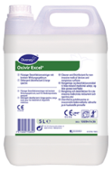
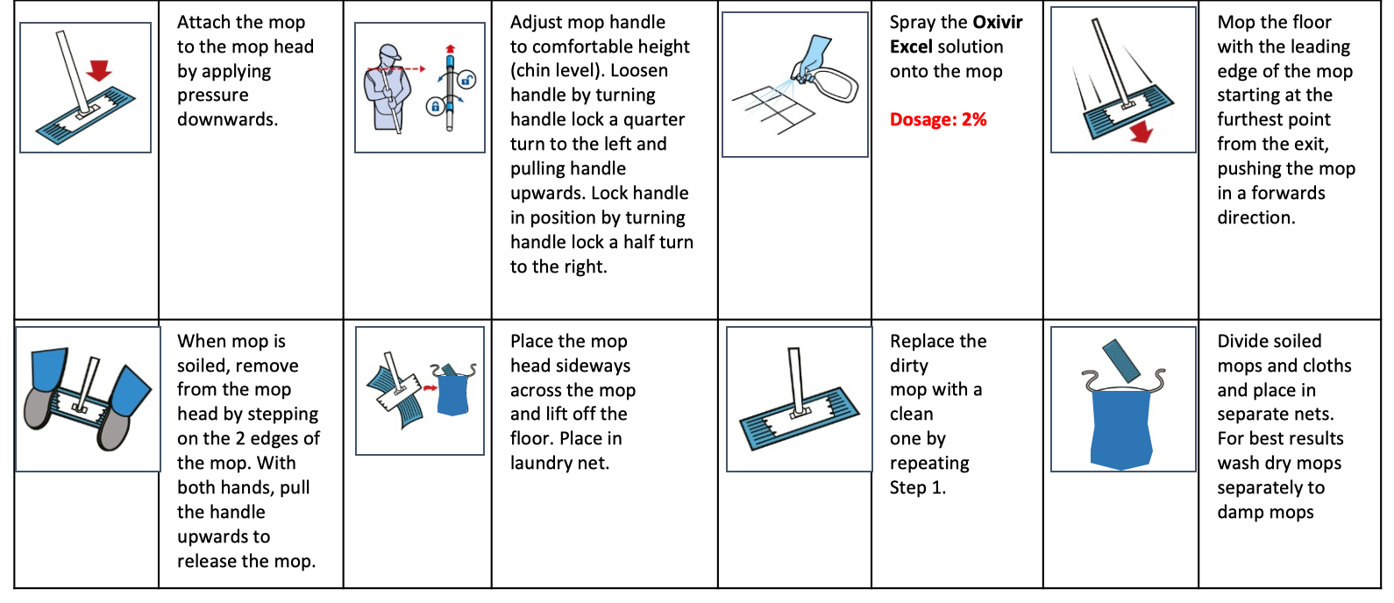


HARD FLOORS DISINFECTION
Cleaning product
Cleaning PROCESS
Broad spectrum cleaner disinfectant*
Short contact time
Effective against SARS-CoV-2
Jonmaster system
WHEN TO DO IT
Cleaning PROCESS
Before (re)opening
Daily in case of outbreak
Wash hands & put on gloves
Clean the key touchpoints
Dispose of dirty cloths in the laundry bag
Discard used gloves
Wash hands
* Please check PIS, SDS for detailed information http://sds.diversey.com | Use biocides safely. Always read the label and product information before use

Slide 3

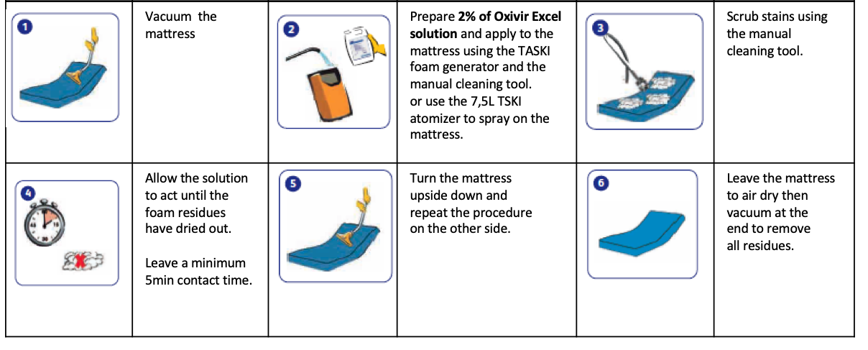

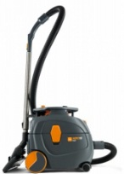
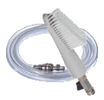
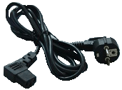
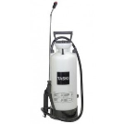
MATTRESS SANITIZATION
Cleaning product
Cleaning PROCESS
Oxivir Excel
Dosage: 2% for viruses*
Contact time: 5min
Foam generator
OR
Vacuum cleaner
TASKI 7,5L atomizer
WHEN TO DO IT
Cleaning PROCESS
Before (re)opening then every quarter. Daily in case of outbreak if no protector
Wash hands & put on gloves
Clean the key touchpoints
Dispose of dirty cloths in the laundry bag
Discard used gloves
Wash hands
* Please check PIS, SDS for detailed information http://sds.diversey.com | Use biocides safely. Always read the label and product information before use

Slide 4
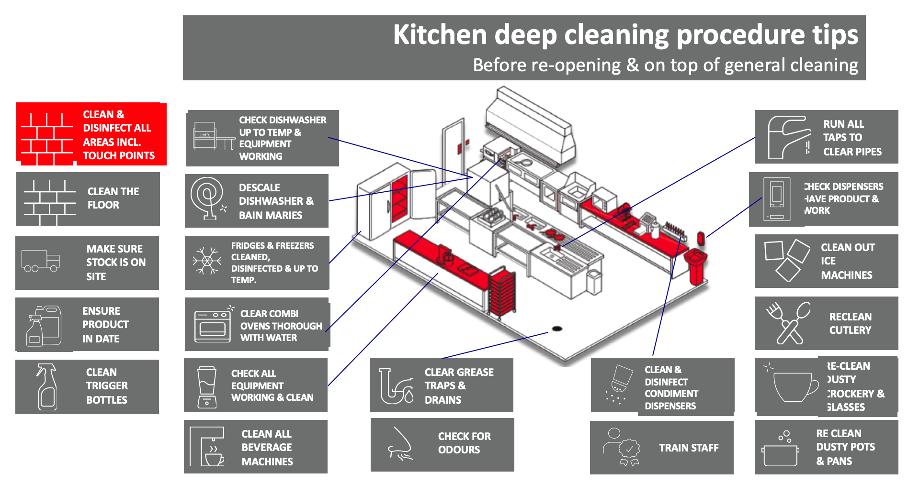
KITCHEN DEEP CLEANING PROCEDURES
Cleaning product
Broad spectrum cleaner disinfectant
Short contact time
Effective against SARS-CoV-2
Jonmaster system
WHEN TO DO IT
Cleaning PROCESS
Before re-opening – check tips and execute once
Wash hands & put on gloves
Clean the key touchpoints
Dispose of dirty cloths in the laundry bag
Discard used gloves
Wash hands
Please check PIS, SDS for detailed information http://sds.diversey.com | Use biocides safely. Always read the label and product information before use

Slide 5
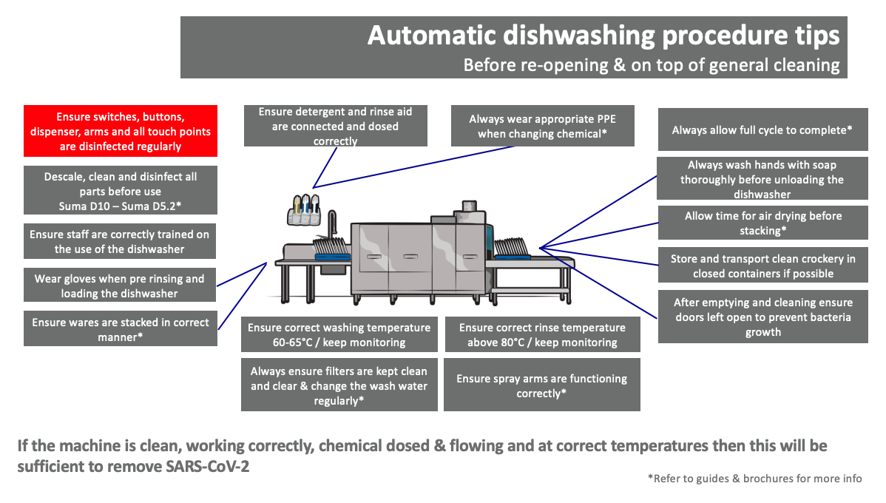
AUTOMATIC DISH WASHER DEEP CLEANING PROCEDURES
Cleaning product
Broad spectrum cleaner disinfectant
Short contact time
Effective against SARS-CoV-2
Jonmaster system
WHEN TO DO IT
Before re-opening – check tips and execute once
Cleaning PROCESS
Wash hands & put on gloves
Clean the key touchpoints
Dispose of dirty cloths in the laundry bag
Discard used gloves
Wash hands
Please check PIS, SDS for detailed information http://sds.diversey.com | Use biocides safely. Always read the label and product information before use

Slide 6
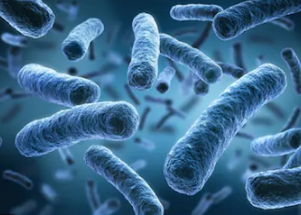
REDUCE RISK OF LEGIONELLA
WHAT TO DO?
WHEN TO DO IT
Before reopening
Flush at high temperatures
Since Legionella bacteria can exist in man-made water systems, it is imperative to ensure the water is stored, maintained and distributed at temperatures that do not encourage the growth and spread of the bacteria.
For all types of buildings, hot-water heater temperatures should be maintained above 140°F (60°C) and the hot-water temperature to distal points (the point of connection to a fixture such as a faucet, showerhead, or thermal mixing valve that blends hot and cold water right before they reach the tap) should exceed 131°F (55°C). A flush of 10 min is recommended when temperatures of 60°C can be reached. A flush of 5 min is sufficient when temperature of 70° can be reached.
Please repeat this with a frequency of 1x/month
It is highly recommended that the staff performing these flushes are protected with FFP3 masks. If temperatures of minimum 60°C cannot be reached, it is recommended to verify the potential contamination with samples taken before re-opening.
Legionella occurs naturally in water from many different environmental sources, but grow rapidly in the warm, stagnant conditions that can occur in facilities were water has not being used during the lockdown.
Therefore it is important to re-assess the risk of legionella before re-opening of a facility. The prevention of Legionella focusses on aerosol-producing warm water-containing sources such as cooling towers, spas, fountains, showers & hot water holding tanks.
Diversey Consulting offers support services for set up or check of kitchen’s organization flow and planning, as well as implementation of the recommendations for food safety safeguard.
Please check PIS, SDS for detailed information http://sds.diversey.com | Use biocides safely. Always read the label and product information before use

Slide 7
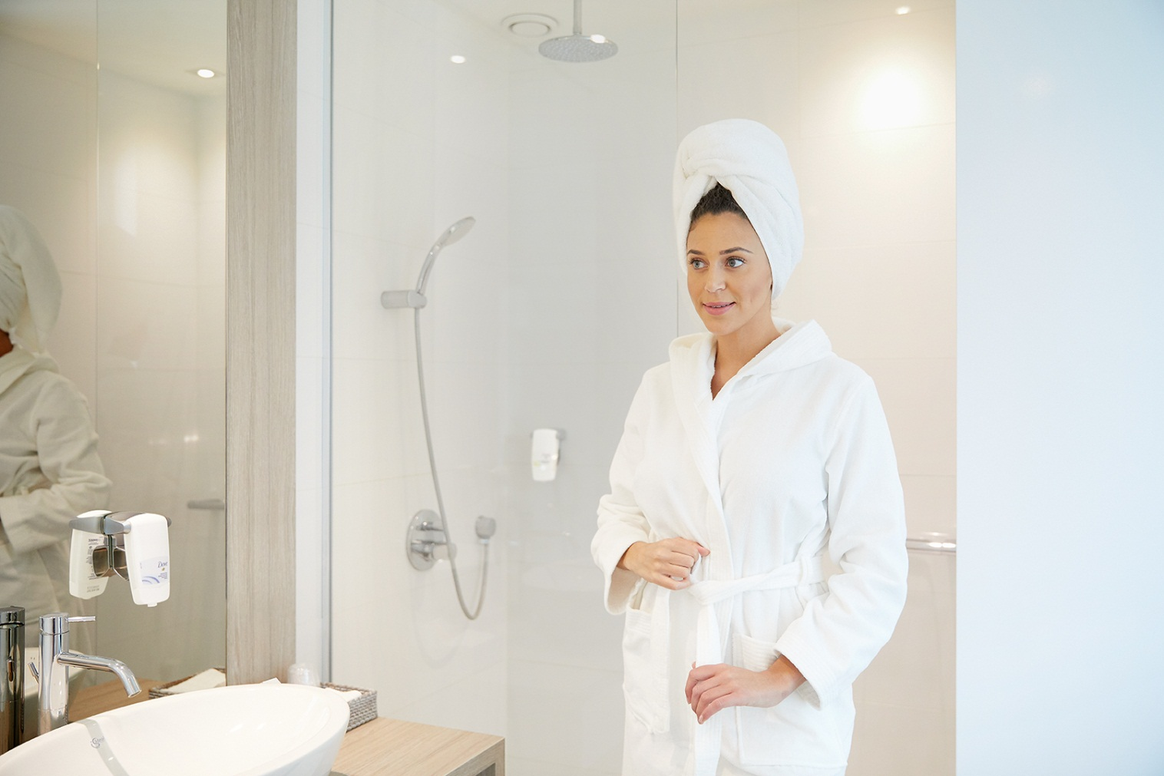

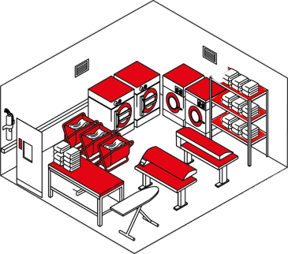
LINEN MANAGEMENT TIPS – BEFORE REOPENING
WHEN TO DO IT
Before
re-opening
WHAT TO DO?
WHAT TO DO?
In the guest rooms
Wash all linen from guest rooms including linen in the storage rooms
Wash curtains, pillows, blankets and duvets to create fresh and clean ambiance
Check any damaged linen that needs to be replaced and repurpose it through our “Linens for Life”TM program
In the laundry
Always wear PPE in line with local public health guidelines and check Enhanced Cleaning Guidelines for Laundry
Clean all general surfaces in the laundry facility and disinfect all critical touch points
Wash any dirty textiles still remaining in laundry, including reusable laundry bags
Set preventative maintenance for dispenser, washing and drying machines
Please check PIS, SDS for detailed information http://sds.diversey.com | Use biocides safely. Always read the label and product information before use

Slide 8
LINEN MANAGEMENT TIPS – BEFORE REOPENING
Items | WHAT TO DO? | Laundry Solutions
Bed and bath linen Pillow case & duvet cover Mattress, pillow and duvet protectors Spa towel and F&B linen | Wash all linen, including linen from storage rooms Always check care labels | Follow best recommended Clax disinfection program based on linen supplier’s recommendations
Curtains (cotton / synthetic) Sofa covers Cover of decoration pillows* Bed skirts* | Always check care labels | Follow best recommended Clax disinfection program based on linen supplier’s recommendations Dry Cleaning is an alternative option**
Blankets* | Always check care labels Put in linen bags and securely seal the bags for 4 days and perform regular washing process after. | Follow best recommended Clax standard program based on linen supplier’s recommendations
Staff uniforms | Always check care labels | Follow best recommended Clax disinfection program based on linen supplier’s recommendations Dry Cleaning is an alternative option**
Mattress – Sofa | Refer to in-room cleaning guidelines | In-room cleaning solutions
*In COVID-19 situation, we recommend to temporarily refrain the use of these items
**Ask virucidal efficacy statement from your Dry Cleaning suppliers
Please check PIS, SDS for detailed information http://sds.diversey.com | Use biocides safely. Always read the label and product information before use

Slide 9
LINEN MANAGEMENT TIPS – BEFORE REOPENING
Items | WHAT TO DO? | Laundry Solutions
With protector
Pillows Duvets | Remove both layers: pillow/duvet cases/covers & protectors Always check Care labels | Follow best recommended Clax standard program based on linen supplier’s recommendations
Without protector – after re-opening, recommend to always use protectors
Synthetic pillows Synthetic duvets | Always check care labels | Follow best recommended Clax disinfection program based on linen supplier’s recommendations Dry Cleaning is an alternative option**
Duvets with feathers Pillows with feathers | Always check Care labels Put in linen bags and securely seal the bags for 4 days and perform regular washing process after. | Follow best recommended Clax standard program based on linen supplier’s recommendations
**Ask virucidal efficacy statement from your Dry Cleaning suppliers
Please check PIS, SDS for detailed information http://sds.diversey.com | Use biocides safely. Always read the label and product information before use

Slide 10
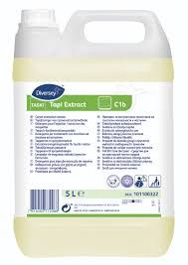
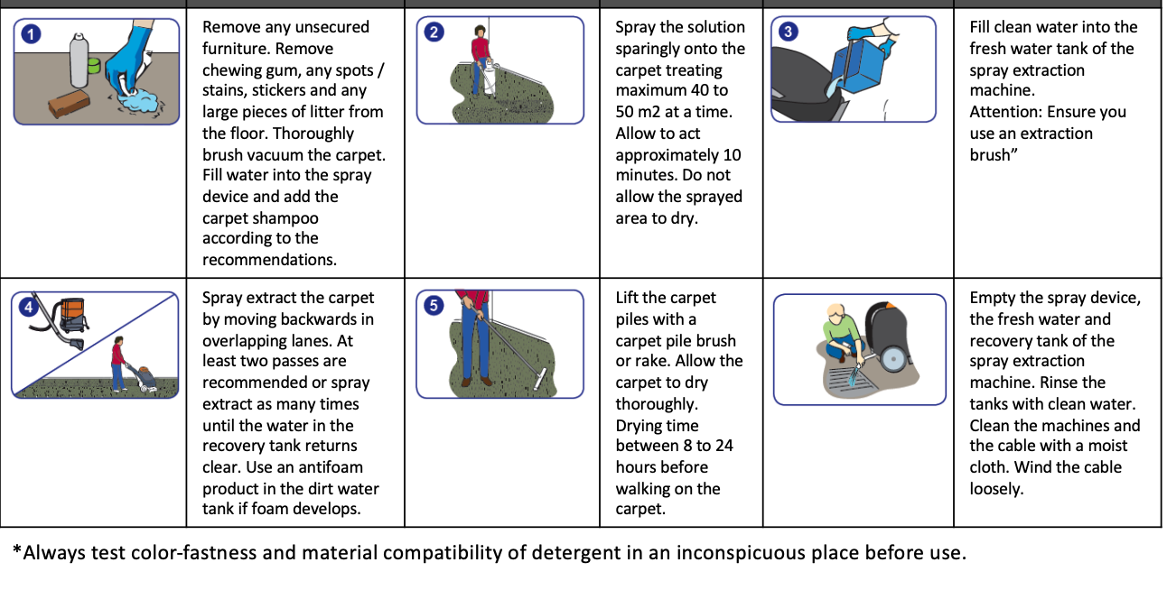
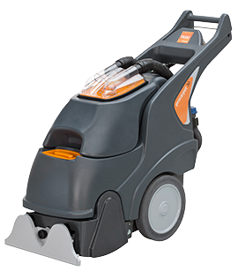
CARPET DEEP CLEANING
Cleaning product
Cleaning PROCESS
TASKI Tapi extract
Dosage: 5%
TASKI Pro carpet 30/45
WHEN TO DO IT
Cleaning PROCESS
As needed to remove stains and refresh carpets
Wash hands & put on gloves
Clean the key touchpoints
Dispose of dirty cloths in the laundry bag
Discard used gloves
Wash hands
* Please check PIS, SDS for detailed information http://sds.diversey.com | Use biocides safely. Always read the label and product information before use

Slide 11

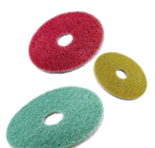
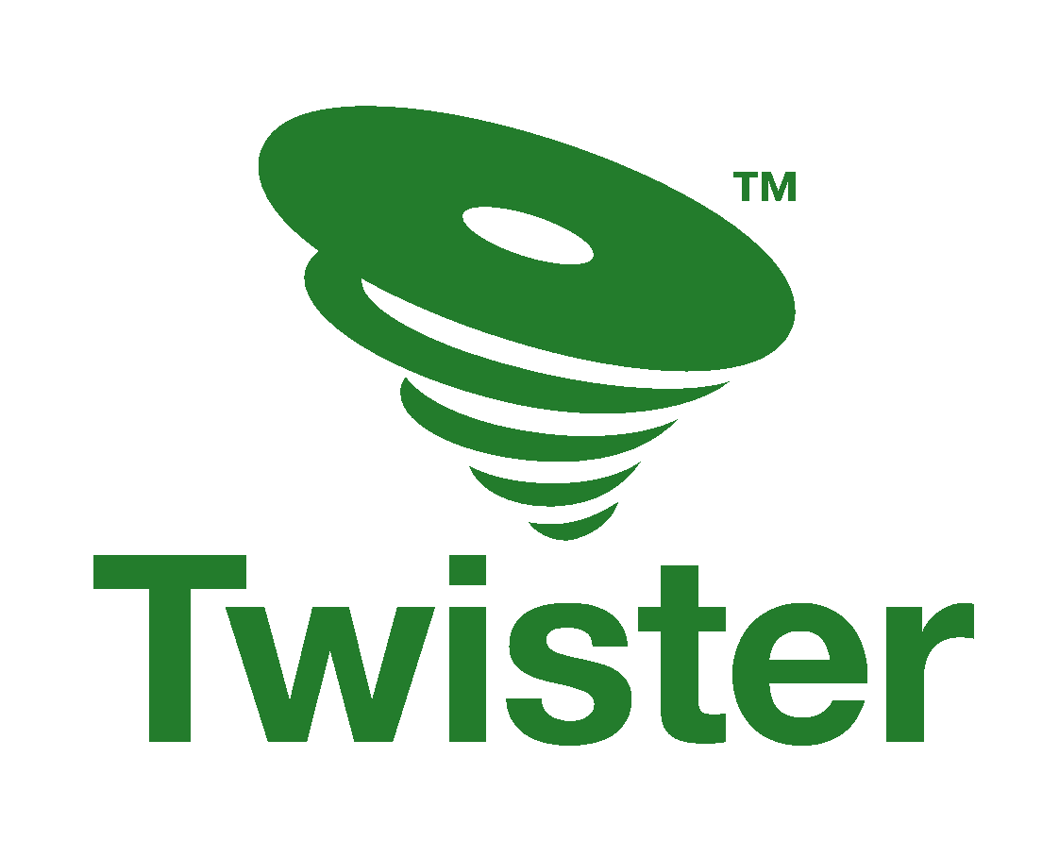

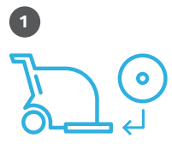
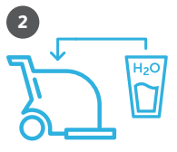

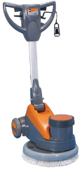
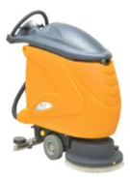
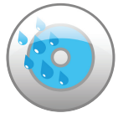

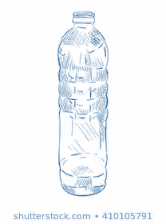


SHINY HARD FLOORS
Cleaning product
Cleaning PROCESS
Only use water
&
Twister by Diversey is a revolutionary set of floor care pads made from recycled PET, impregnated with billions of microscopic diamonds, that clean and micro-polish your floor at the same time. Completely without chemicals.
Besides by cleaning and polishing the floor with billions of microscopic diamonds, Twister creates a smoother surface that is harder to breach by bacteria and easily eliminated during daily cleaning. While floors get constantly re-soiled with traffic, efficient elimination of pathogen presence will increase safety.
🗹 365 days great looking hard floors for your guests ! No up, no down periods.
🗹 Reduce: up to 67% less pads thanks to ultra-durability 🗹 Reuse: each pad is made of 2,6 recycled PET bottles 🗹 Remove: no chemicals, just water!
🗹 Achieve between 20 and 40% operational costs reduction. Extended floors lifetime.
Twister Pads
 | Mount the pad coloured side down. |  | Fill the machine with water only! |  | Daily cleaning routine.
 | After each use, rinse the TwisterTM pad. |  | If the colour is gone, change the pad.
Scrubber dryers
Single-disc machines
OR
WHEN TO DO IT
Cleaning PROCESS
As needed to improve gloss level
Wash hands & put on gloves
Mount the pad coloured side down
Fill the machine with water only
Clean your floors with your daily cleaning routine.
Rinse pad after use (with water)
Discard used gloves
Wash hands
* Please check PIS, SDS for detailed information http://sds.diversey.com | Use biocides safely. Always read the label and product information before use

Slide 12
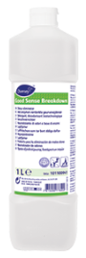
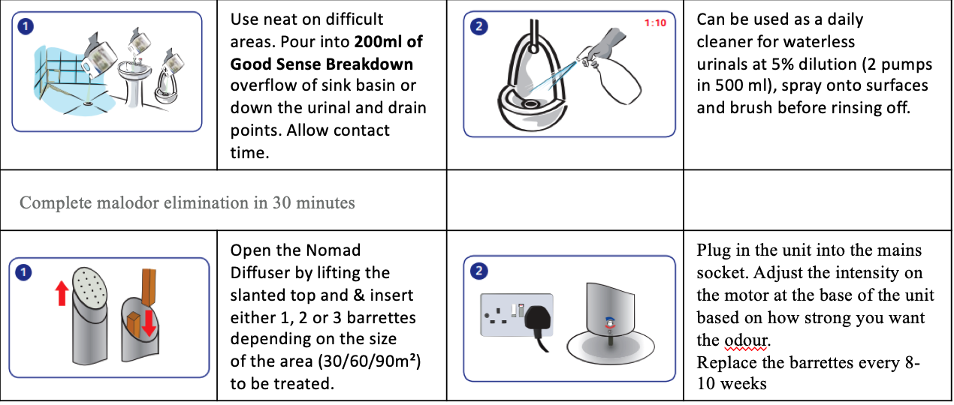
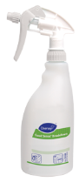

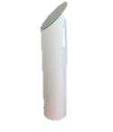
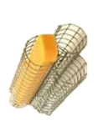
ODOUR CONTROL
Cleaning product
Cleaning PROCESS
Good Sense Breakdown
Dosage: 5% - neat*
Good Sense Nomad aroma diffuser
with patented Gel-active technology
Perfumed
gel-active molecules
WHEN TO DO IT
Cleaning PROCESS
As malodour occurs
Wash hands & put on gloves
Follow process as described above
Discard used gloves
Wash hands
* Please check PIS, SDS for detailed information http://sds.diversey.com | Use biocides safely. Always read the label and product information before use

Slide 13
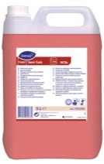
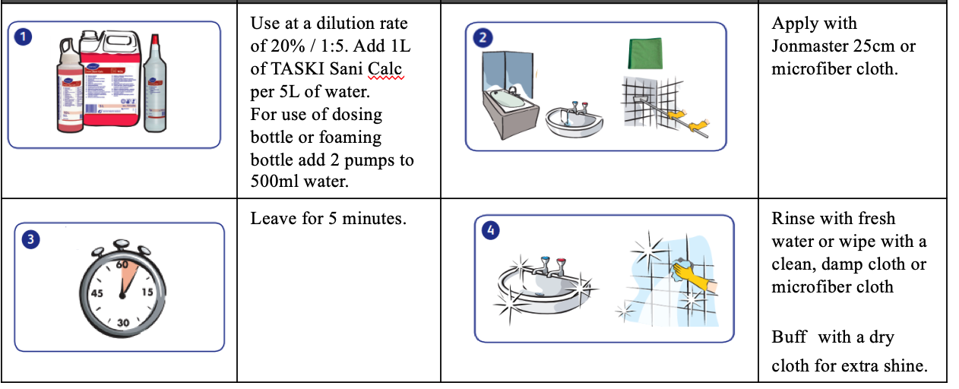

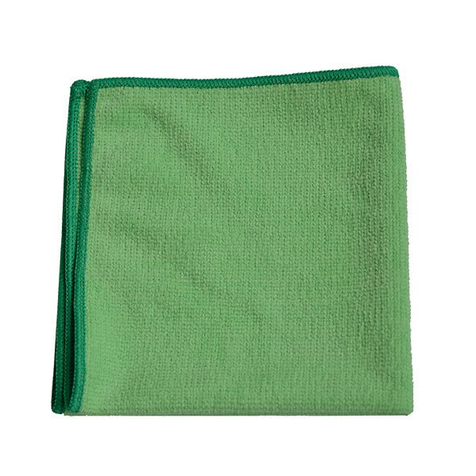
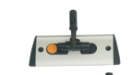
HEAVY DESCALING (FLOORS, WALLS, WASHROOMS)
Cleaning product
Cleaning PROCESS
TASKI Sani Calc
Dosage: 20%
Jonmaster system 25cm / Jonmaster Ultra cloth XL
green
or
WHEN TO DO IT
Cleaning PROCESS
As build up is visible
Wash hands & put on gloves
Follow process as described above
Discard used gloves
Wash hands
* Please check PIS, SDS for detailed information http://sds.diversey.com | Use biocides safely. Always read the label and product information before use

Slide 14
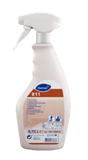
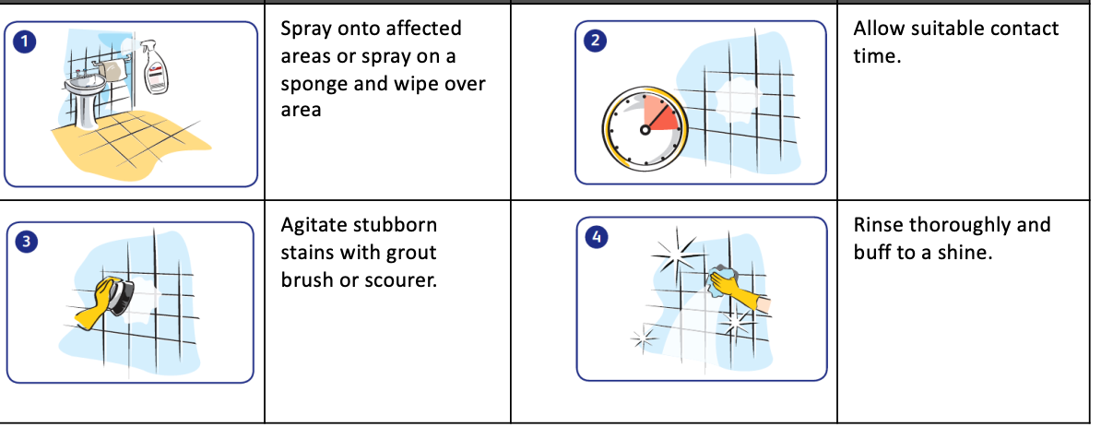
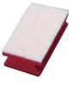
MOULD AND MILDEW REMOVAL
Cleaning product
Cleaning PROCESS
Room Care R11
Ready-to-use
Sponge scourer or grout brush
WHEN TO DO IT
Cleaning PROCESS
As build up is visible
Wash hands & put on gloves
Follow process as described above
Discard used gloves
Wash hands
* Please check PIS, SDS for detailed information http://sds.diversey.com | Use biocides safely. Always read the label and product information before use

