Slide 1

LAUNDRY RECOMMENDATIONS
COVID-19 recommendations for the wash process
Laundry room cleaning procedure
Linen management tips
Laundry room cleaning procedure
Linen management tips- before reopening
Linen management tips – after reopening
Strengthening our Partnership with Linen For LifeTM
Laundry – post spotting
* Please ensure the cleaning products you are using are effective against SARS-CoV-2 according to the European test EN14476 or your Local Authority’s recommendations

Slide 2


COVID-19 RECOMMENDATIONS FOR THE WASH PROCES
Clax disinfection programs
Thermal disinfection Preferred option - easier to implement, and more flexible | Chemo-thermal disinfection Recommended for items that cannot withstand high temp
Wash program requires specific temperature and contact time to achieve disinfection | Wash program requires a combination of chemicals, temperature and contact time to achieve disinfection
Wash program NOT dependent on specific products for disinfection | Wash program dependent on specific products effective against SARS-CoV-2; in addition, all wash process steps need to be followed exactly as described
WHO guidelines for thermal disinfection 70 ⁰C for 25 minutes More stringent RKI guidelines also allowed 85 ⁰C for 15 minutes 90 ⁰C for 10 minutes | Product should be effective against SARS-CoV-2 following the European EN14476 test or other parvovirus test as for RKI. For example program with Clax Personril with adapted wash process
*
*RKI listed processes are recognized as one of the highest standards to handle any kind of outbreak.
Notes: Please contact your local Diversey contact for more information
Example of Clax Disinfection programs can be found in the back-up slides
For the laundry process, follow a locally authorized wash process (i.e. local CDC)
* Check PIS, SDS for detailed information http://sds.diversey.com | Use biocides safely. Always read the label and product information before use

Slide 3
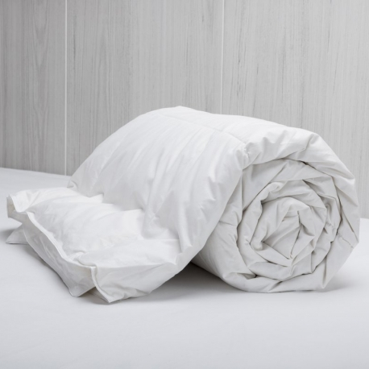
LAUNDRY ROOM CLEANING PROCEDURE
For some delicate items, like for example duvets with feathers, thermal nor chemo-thermal disinfection can be applied
In those cases, it is recommended to put the delicate items into a closed linen or plastic bag and securely seal this bag for 4 days before following a standard wash process
This recommendation is based on a recent US funded study endorsed by WHO that concludes SARS-CoV-2 (Coronavirus) can survive max 3 days*. We have added 1 extra day for safety
It ensures that the delicates will be washed with extra care and not damaged by high temperature or a chemicals
Dry Cleaning is an alternative option; requires virucidal efficacy statement from Dry Cleaners (see back up slide)
* Check PIS, SDS for detailed information http://sds.diversey.com | Use biocides safely. Always read the label and product information before use

Slide 4

LINEN MANAGEMENT TIPS
Below some suggestions for additional precautionary measures to prevent cross-contamination through linen and to make sure your hotel provides a safe and healthy environment:
Use protectors for all pillows, duvets and mattresses
This provides an extra layer of safety
For pillows, use pillow case and protector
For duvets, use duvet cover and protector
For mattress, use bed sheet and protector
Increase frequencies of laundering duvets without protector to after every guest check-out
Temporarily refrain the use of items such as blankets, bed skirts and decoration pillows and limit/remove the Guest linen laundry service. After washing & drying, seal items in linen or plastic bags before storage
For facilities that outsource laundry:
agree on procedures for linen collection
ask statement from Commercial Laundry that they comply with all the required infection prevention requirements
* Check PIS, SDS for detailed information http://sds.diversey.com | Use biocides safely. Always read the label and product information before use

Slide 5
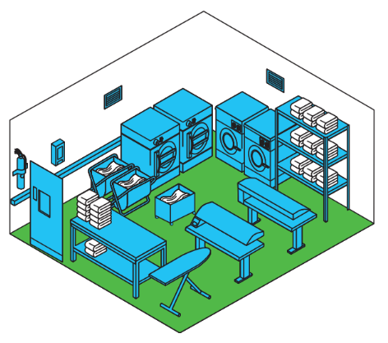
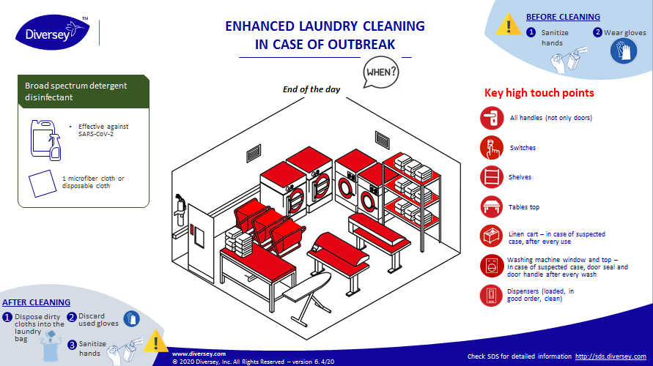

LAUNDRY ROOM CLEANING PROCEDURE
Step 1 cleaning
Outstanding Cleanliness
+
Healthcare grade disinfection
Step 2 disinfecting
Regular daily cleaning
Use your current cleaning process
Disinfecting key touch points
Use the enhanced process
Glass & multi-surface cleaner
Floor cleaner
* Check PIS, SDS for detailed information http://sds.diversey.com | Use biocides safely. Always read the label and product information before use

Slide 6

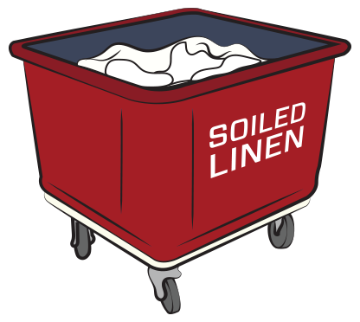
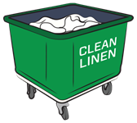
LAUNDRY ROOM CLEANING PROCEDURE
To prevent cross contamination, follow infection prevention procedures for handling linen
Wear appropriate PPE, check local public health guidelines
Generic recommendations: gloves, masks and gown
Collect soiled linen from guest rooms then sort and separate into different labeled carts with cover to prevent sorting and linen agitation in the laundry room (example: 1 for bath linen and 1 for bed linen)
Before handling clean linen, remove gloves and the gown, sanitize hands with alcohol-based sanitizer, then put on new gloves
Use colour-coded cart/trolleys for soiled linen (red) and clean linen (green or blue)
If linen chute is used, schedule time to use linen chutes so that no one is in the laundry when bags are dropped from high floors and prevent bags from bursting when landing in the laundry room
Wash linen immediately when it arrives in the laundry room
Suspend pre-spotting to minimize risk of infection through direct contact before washing and disinfection process
* Check PIS, SDS for detailed information http://sds.diversey.com | Use biocides safely. Always read the label and product information before use

Slide 7
LINEN MANAGEMENT TIPS – BEFORE REOPENING
Items | WHAT TO DO? | Laundry Solutions
Bed and bath linen Pillow case & duvet cover Mattress, pillow and duvet protectors Spa towel and F&B linen | Wash all linen, including linen from storage rooms Always check care labels | Follow best recommended Clax disinfection program based on linen supplier’s recommendations
Curtains (cotton / synthetic) Sofa covers Cover of decoration pillows* Bed skirts* | Always check care labels | Follow best recommended Clax disinfection program based on linen supplier’s recommendations Dry Cleaning is an alternative option**
Blankets* | Always check care labels Put in linen bags and securely seal the bags for 4 days and perform regular washing process after. | Follow best recommended Clax standard program based on linen supplier’s recommendations
Staff uniforms | Always check care labels | Follow best recommended Clax disinfection program based on linen supplier’s recommendations Dry Cleaning is an alternative option**
Mattress – Sofa | Refer to in-room cleaning guidelines | In-room cleaning solutions
*In COVID-19 situation, we recommend to temporarily refrain the use of these items
**Ask virucidal efficacy statement from your Dry Cleaning suppliers
Check PIS, SDS for detailed information http://sds.diversey.com | Use biocides safely. Always read the label and product information before use

Slide 8
LINEN MANAGEMENT TIPS – BEFORE REOPENING
Items | WHAT TO DO? | Laundry Solutions
With protector
Pillows Duvets | Remove both layers: pillow/duvet cases/covers & protectors Always check Care labels | Follow best recommended Clax standard program based on linen supplier’s recommendations
Without protector – after re-opening, recommend to always use protectors
Synthetic pillows Synthetic duvets | Always check care labels | Follow best recommended Clax disinfection program based on linen supplier’s recommendations Dry Cleaning is an alternative option**
Duvets with feathers Pillows with feathers | Always check Care labels Put in linen bags and securely seal the bags for 4 days and perform regular washing process after. | Follow best recommended Clax standard program based on linen supplier’s recommendations
**Ask virucidal efficacy statement from your Dry Cleaning suppliers
Check PIS, SDS for detailed information http://sds.diversey.com | Use biocides safely. Always read the label and product information before use

Slide 9
LAUNDRY CLEANING & DISINFECTION – after re-opening
Items | Guidelines | Laundry Solutions | Frequency
Bed and bath linen Pillow case & duvet cover Mattress, pillow & duvet protectors Spa towel and F&B linen | Always check care labels | Follow best recommended Clax disinfection program based on linen supplier’s recommendations | Daily for used bath linen Daily for spa towel and F&B linen After every guest check-out for all linen in the Guest Room (used and not used)
Curtains (cotton / synthetic) Sofa covers Cover of decoration pillows* Bed skirts* | Always check care labels | Follow best recommended Clax disinfection program based on linen supplier’s recommendations Dry Cleaning is an alternative option** | Double current hotel practice for curtains, bed skirt, sofa covers After every guest check-out for cover of decoration pillow
Staff Uniforms | Always check care labels | Follow best recommended Clax disinfection program based on linen supplier’s recommendations Dry Cleaning is an alternative option** | Daily
*In COVID-19 situation, we recommend to temporarily refrain the use of these items
**Ask virucidal efficacy statement from your Dry Cleaning suppliers
Check PIS, SDS for detailed information http://sds.diversey.com | Use biocides safely. Always read the label and product information before use

Slide 10
LAUNDRY CLEANING & DISINFECTION – after re-opening
Items | Guidelines | Laundry Solutions | Frequency
Guest Linen | Always check care labels | Follow best recommended Clax disinfection program based on linen supplier’s recommendation Dry Cleaning is an alternative option** | On request
With protector
Pillows Duvets | Remove both layers (pillow/duvet cases/covers & protectors) Always check Care labels | Follow best recommended Clax standard program based on linen supplier’s recommendations | Double current hotel practice
Without protector – after re-opening, recommend to always use protectors
Synthetic pillows Synthetic duvets | Always check care labels | Follow best recommended Clax disinfection program based on linen supplier’s recommendations Dry Cleaning is an alternative option** | After every guest check-out
Duvets with feathers Pillows with feathers | Always check Care labels Put in linen bags and securely seal the bags for 4 days and perform regular washing process after | Follow best recommended Clax standard program based on linen supplier’s recommendations | After every guest check-out
*In COVID-19 situation, we recommend to temporarily refrain the use of these items
**Ask virucidal efficacy statement from your Dry Cleaning suppliers
Check PIS, SDS for detailed information http://sds.diversey.com | Use biocides safely. Always read the label and product information before use

Slide 11
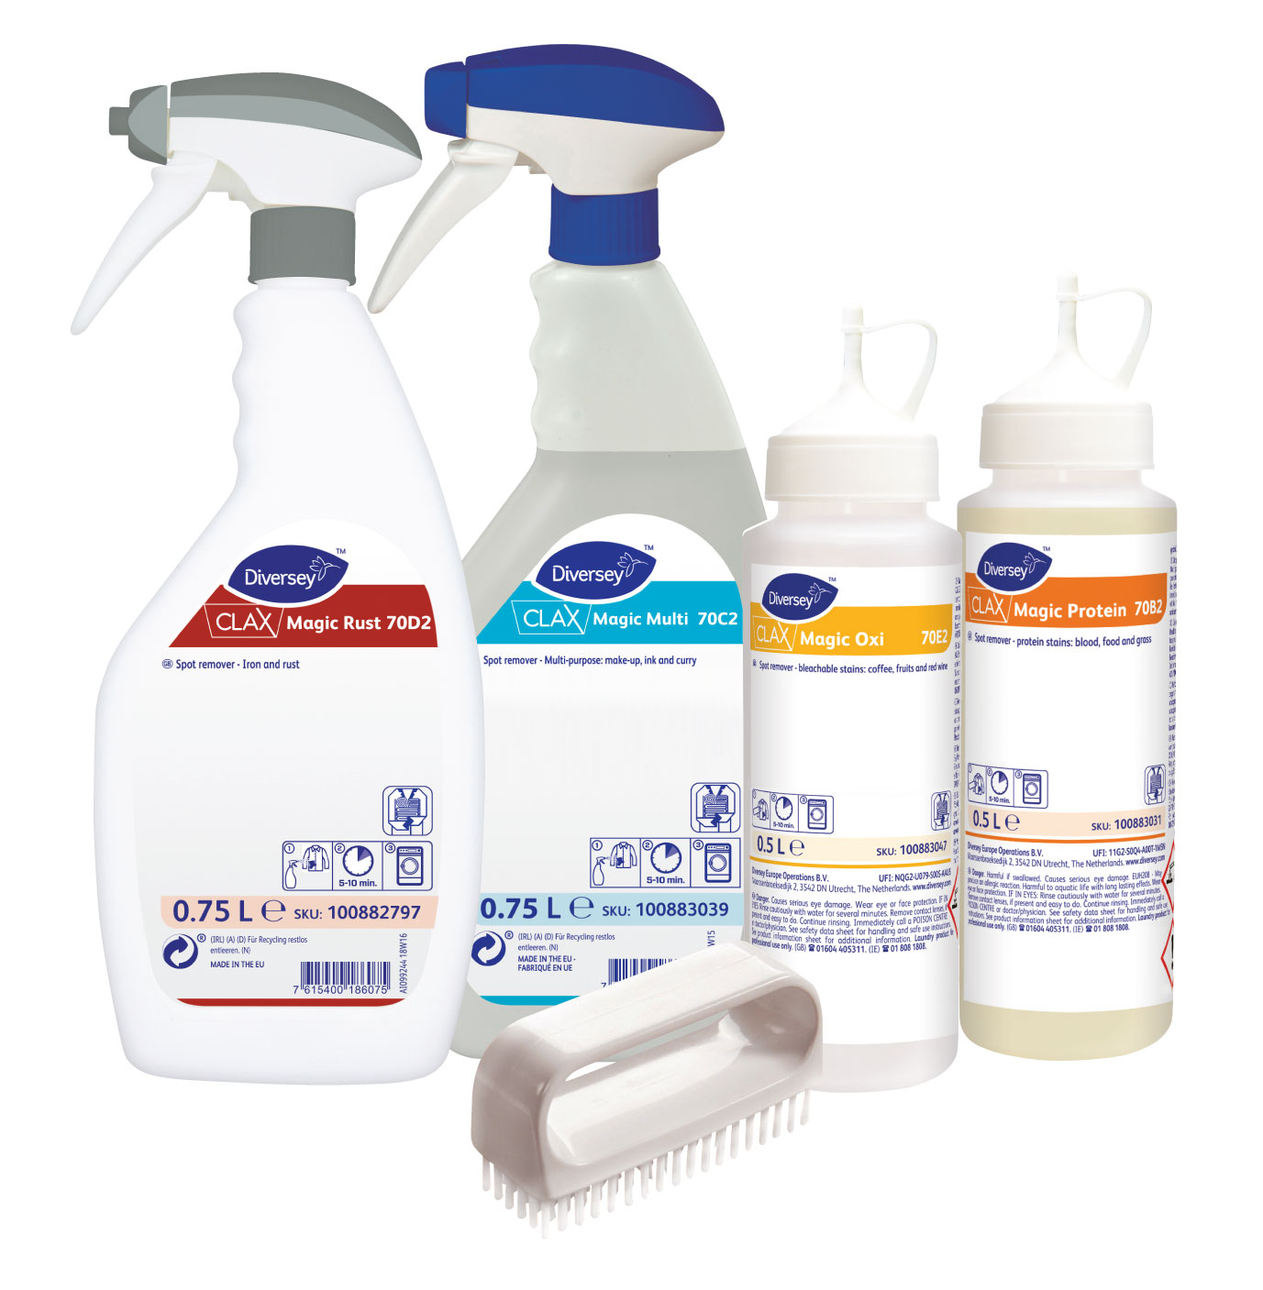
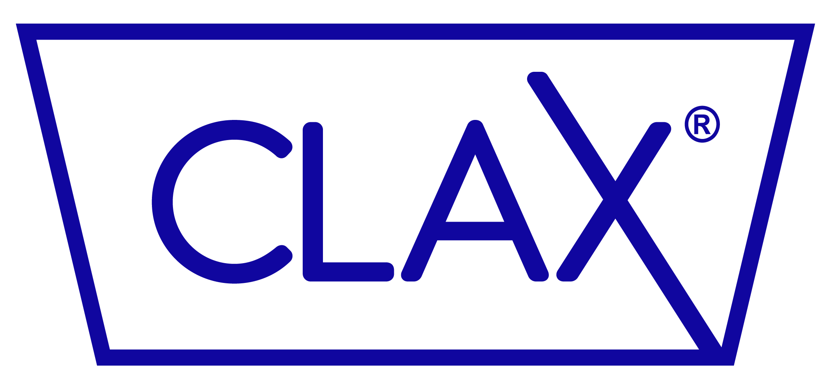

LAUNDRY CLEANING & DISINFECTION – POST-SPOTTING
Cleaning product
 | Pre-spotting | Post-spotting
Pre-opening: Deep cleaning | / | +
Re-opening: Enhanced cleaning | / | +
Normal Operation | + | +
Magic
A complete stain removal solution
WHEN TO DO IT
Whenever a stain occurs in your fabrics
  Pre-spotting should be suspended to minimize risk of infection through direct contact of linen before washing and disinfection.
  Use Clax Magic for post-spotting only
Cleaning PROCESS
Wash hands & put on gloves
Spray the product on the stain
Wash as normal process
Dispose of dirty cloths in the laundry bag
Discard used gloves
Wash hands
* Check PIS, SDS for detailed information http://sds.diversey.com | Use biocides safely. Always read the label and product information before use

Slide 12
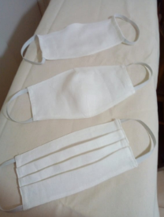


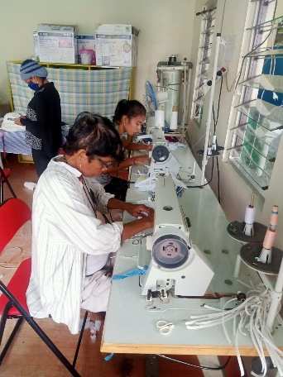
STRENGHTENING OUR PARTNERSHIP WITH LINENS FOR LIFETM
Cleaning product
Turning discarded linen to face masks
As of 20 April 2020, there are currently 5 Linens For Life™ face masks projects in 8 cities across Asia and Europe, with 11 partner hotels. More than 50,000 masks have been given, with our partner hotels and NGOs, to local communities and hospitals in COVID-19 areas. We recommend wash and clean discarded linen before giving away to NGOs.
WHEN TO DO IT
Together with hotels and NGOs, we drive programs that create shared value for local communities.
Whenever you need to discard of linens that cannot be used anymore
5
projects
8
cities
11
Partners hotels
80
More in pipeline
Cleaning PROCESS
Wash hands & put on gloves
Share the linen that would otherwise be discarded, with Diversey team
We will bring it to an NGO in your community and repurpose the linen into renewed linens.
Share the face masks with your community
Check PIS, SDS for detailed information http://sds.diversey.com | Use biocides safely. Always read the label and product information before use

