Slide 1


ENHANCED CLEANING
Key touchpoints disinfection
Entrance
Reception & lobby
Luggage room
Public washrooms
Guest room
Kitchen
Restaurant & bar
Fitness area
Pool area
Kids club
Conference / Meeting room
Club lounge
Colleague facilities
Laundry
Spa treatment room
Please ensure the cleaning products you are using are effective against SARS-CoV-2 according to the European test EN14476 or your Local Authority’s recommendations

Slide 2
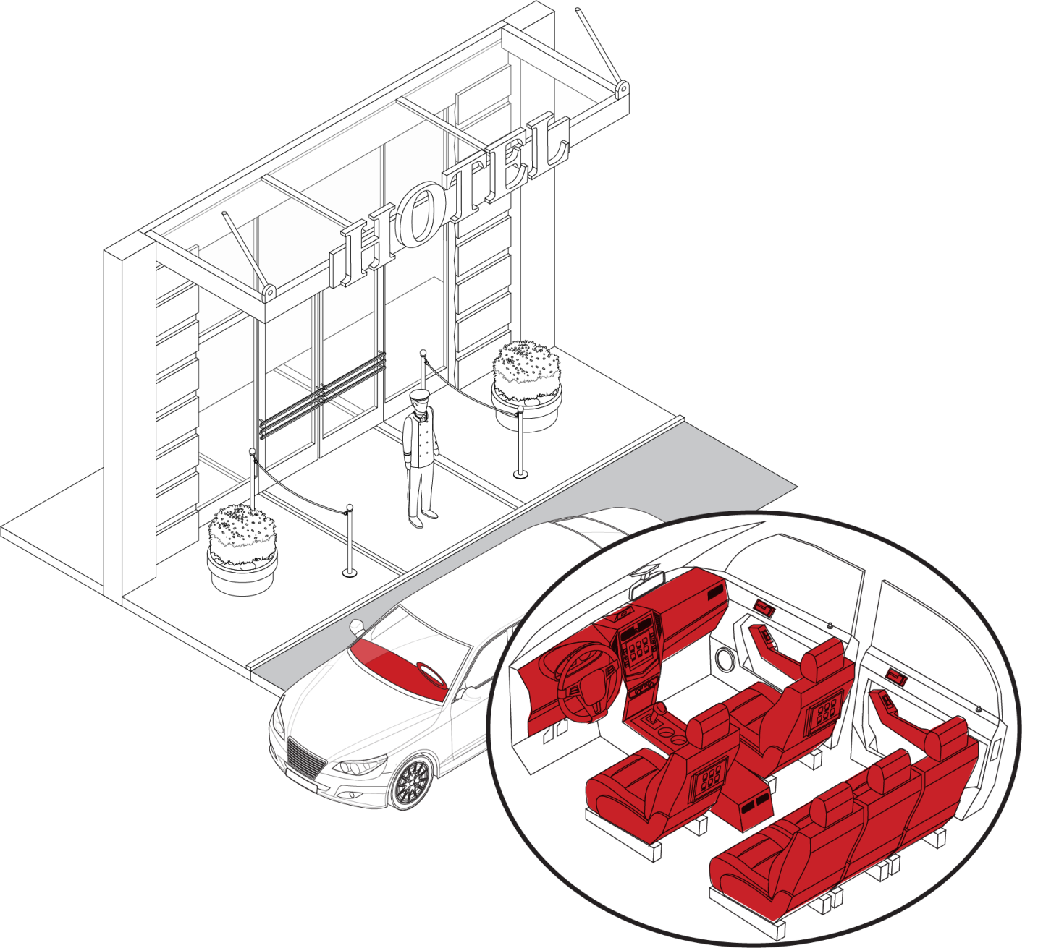


CLEANING THE HOTEL ENTRANCE
KEY TOUCHPOINTS
CLEANING PRODUCT
Dashboard
Broad spectrum detergent disinfectant wipes
Wheel
Short contact time
Effective against SARS-CoV-2
Speed knob
Car seats and armrest
Door handles
(car interior and exterior,
and main entrance)
WHEN TO DO IT
Between
guests
CLEANING PROCESS
Wash hands & put on gloves
Clean the key touchpoints
Dispose of dirty cloths in the laundry bag
Discard used gloves
Wash hands
Check PIS, SDS for detailed information http://sds.diversey.com | Use biocides safely. Always read the label and product information before use

Slide 3
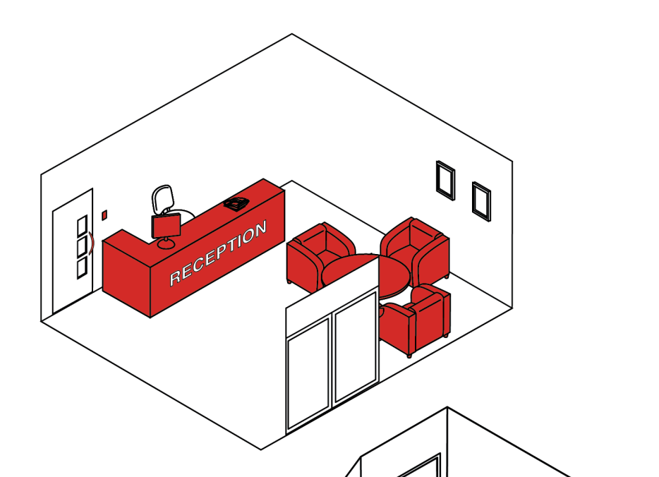








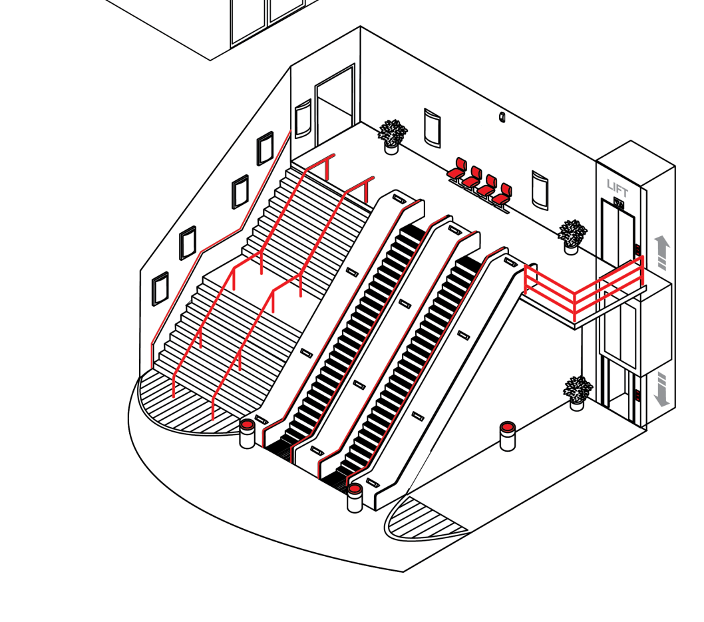






RECEPTION AND LOBBY CLEANING
KEY TOUCHPOINTS
CLEANING PRODUCT
Armchairs
Pens
Broad spectrum detergent disinfectant
Coffee machines/
Water fountain
Phone
Short contact time
Effective against SARS-CoV-2
Door handles
Room key card
Hand rails
Tables
WHEN TO DO IT
Lift button
Rubbish bin
Every hour except the front desk - after every guest
Mobile phone
Vending machine
Credit card
machine
Sneeze guards
CLEANING PROCESS
Wash hands & put on gloves
Clean the key touchpoints
Dispose of dirty cloths in the laundry bag
Discard used gloves
Wash hands
Check PIS, SDS for detailed information http://sds.diversey.com | Use biocides safely. Always read the label and product information before use

Slide 4
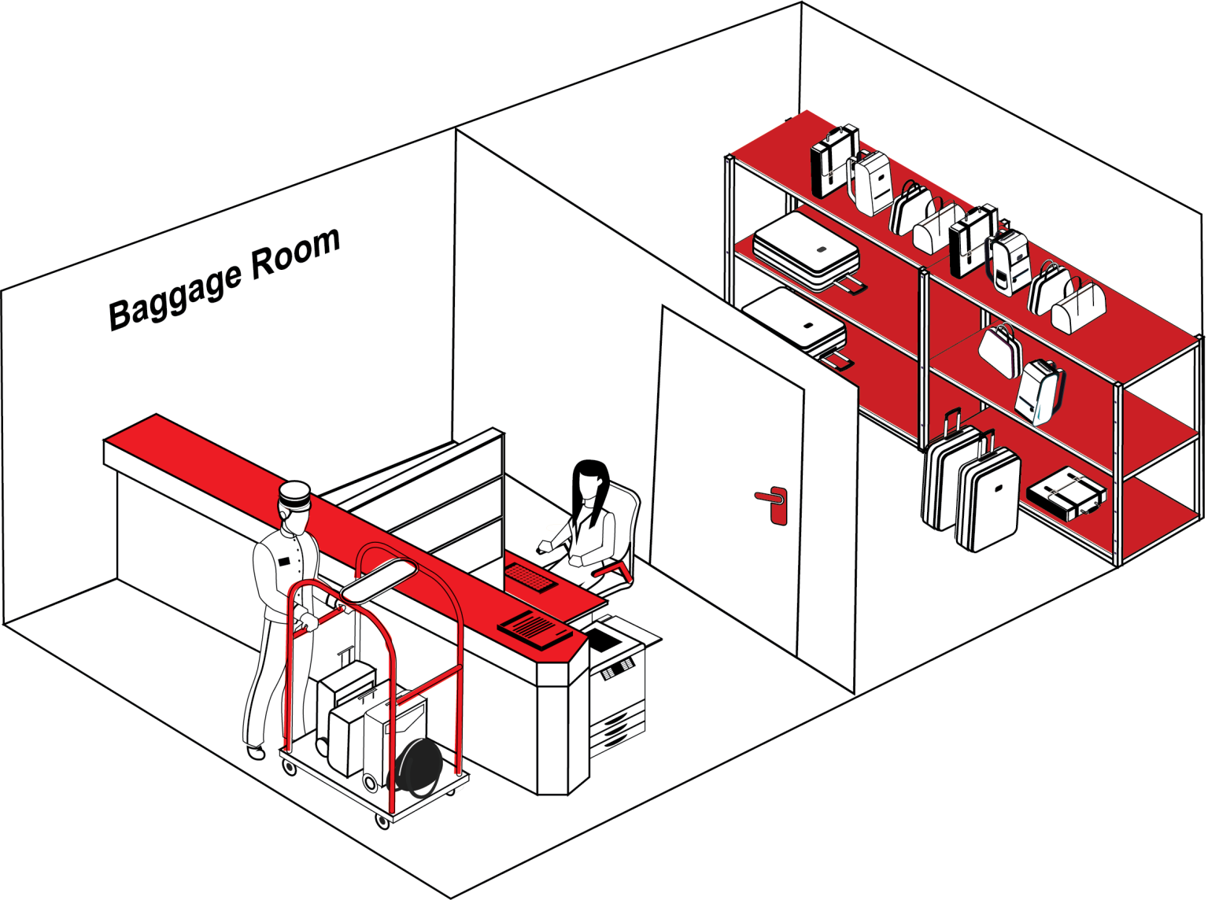
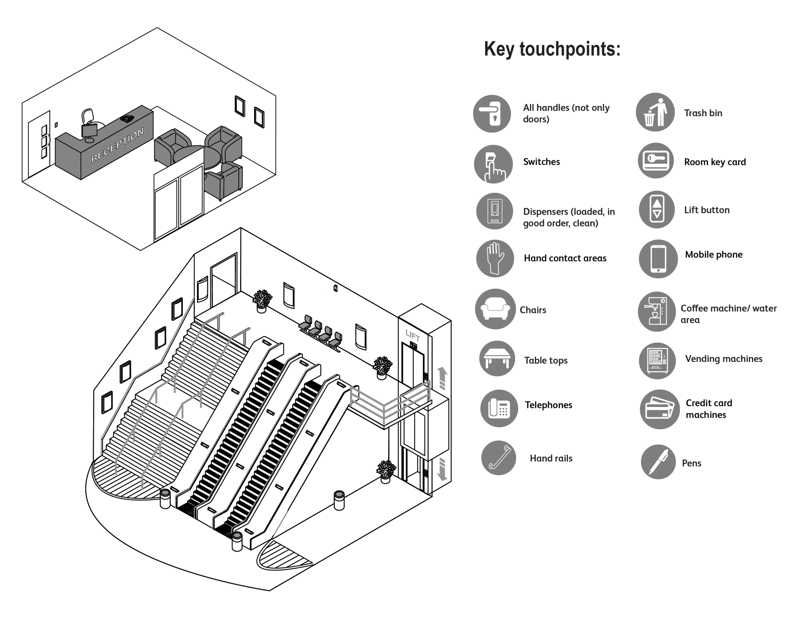


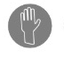



CLEANING THE LUGGAGE ROOM
KEY TOUCHPOINTS
CLEANING PRODUCT
Counter top
Short contact time
Correct dosing
Effective against SARS-CoV-2
Desk
Door handle
1 microfibre cloth*
or disposable cloth
Hand contact areas:
Keyboard, printers key board
* Use a different microfibre cloth colour from your current daily cleaning process for the enhanced cleaning
Luggage carrier
Phone
Shelves
CLEANING PROCESS
WHEN TO DO IT
Wash hands & put on gloves
Clean the key touchpoints
Dispose of dirty cloths in the laundry bag
Discard used gloves
Wash hands
Every hour except the counter and trolley - after every guest
Check PIS, SDS for detailed information http://sds.diversey.com | Use biocides safely. Always read the label and product information before use

Slide 5
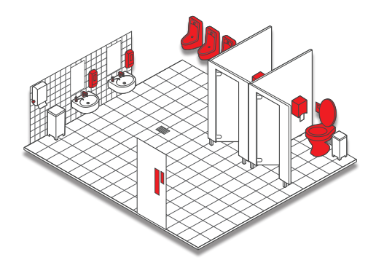





CLEANING PUBLIC WASHROOMS
KEY TOUCHPOINTS
CLEANING PRODUCT
Door handles
Short contact time
Correct dosing
Effective against SARS-CoV-2
Hand contact area:
Paper dispenser
1 microfibre cloth* or disposable cloth for the outside of the toilet bowls and the urinals
Soap dispensers (loaded, in good order, clean)
Switches
1 microfibre cloth* or disposable cloth for the rest of the washrooms
Toilet seat, flush, splash wall
Rubbish bin
* Use a different microfibre cloth colour from your current daily cleaning process for the enhanced cleaning
Water taps
WHEN TO DO IT
CLEANING PROCESS
Every hour
Wash hands & put on gloves
Clean the key touchpoints
Dispose of dirty cloths in the laundry bag
Discard used gloves
Wash hands
Check PIS, SDS for detailed information http://sds.diversey.com | Use biocides safely. Always read the label and product information before use

Slide 6

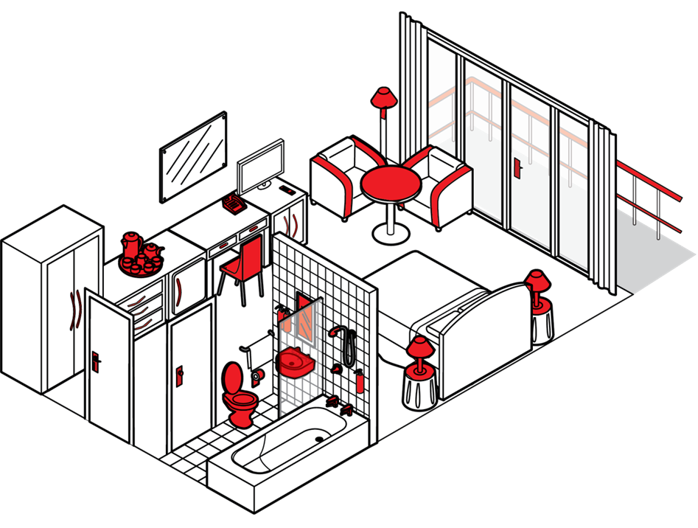













CLEANING GUEST ROOM - DISINFECTION
KEY TOUCHPOINTS
CLEANING PRODUCT
Room accessories (kettles, iron, hair dryer)
AC controller
Short contact time
Correct dosing
Effective against SARS-CoV-2
Armchairs
armrest
Switches
Table tops
1 microfibre cloth* or disposable cloth for the outside of the toilet bowls and the urinals
Balcony rail
Exterior of
Coffee machines
Safe
1 microfibre cloth* or disposable cloth for the rest of the washrooms
Door handles
Bathroom sink
Furniture handles
Toilet seat, flush, splash wall, flush; toilet brush
* Use a different microfibre cloth colour from your current daily cleaning process for the enhanced cleaning
Lamp toggle switch
WHEN TO DO IT
Shower control,
taps
After every exit
Mini bar
Soap dispensers (loaded, in good order, clean)
Phone
CLEANING PROCESS
Remote control
Shower head
Wash hands & put on gloves
Clean the key touchpoints
Dispose of dirty cloths in the laundry bag
Discard used gloves
Wash hands
Check PIS, SDS for detailed information http://sds.diversey.com | Use biocides safely.
Always read the label and product information before use

Slide 7
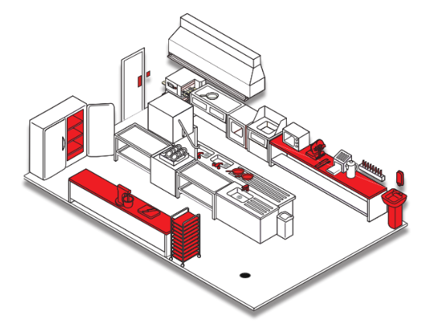


CLEANING KITCHEN - DISINFECTION
KEY TOUCHPOINTS
CLEANING PRODUCT
Door handles
Short contact time
Perfume free
Effective against SARS-CoV-2
Switches
Dispensers (loaded, in good order, clean)
1 microfibre* or disposable cloth to clean and disinfect
Food contact surfaces
1 microfibre* disposable cloth to rinse
Hand contact areas
* Use a different microfibre cloth colour from your current daily cleaning process for the enhanced cleaning
Taps
Utensils
CLEANING PROCESS
Wash hands & put on gloves
Clean the key touchpoints
Rinse thoroughly with clear water
Dispose of dirty cloths in the laundry bag
Discard used gloves
Wash hands
WHEN TO DO IT
After every service
Check PIS, SDS for detailed information http://sds.diversey.com | Use biocides safely. Always read the label and product information before use

Slide 8
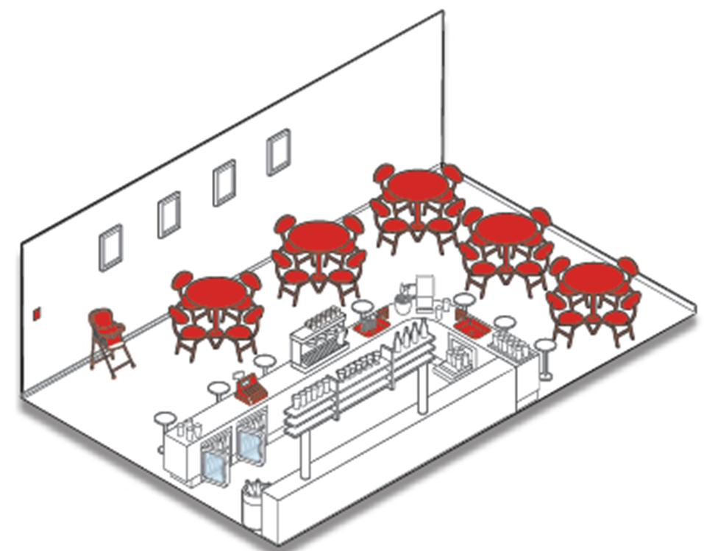


CLEANING RESTAURANT & BAR - DISINFECTION
KEY TOUCHPOINTS
CLEANING PRODUCT
Short contact time
Correct dosing
Perfume free
Effective against SARS-CoV-2
Sneeze guards
Switches
All handles
(not only doors)
Chairs
1 microfibre* or disposable cloth to clean and disinfect
Dispensers (loaded, in good order, clean)
Table and counter tops
1 microfibre* disposable cloth to rinse
Trays
Menu cards
Condiment dispensary
Cashier / credit
card machine
* Use a different microfibre cloth colour from your current daily cleaning process for the enhanced cleaning
CLEANING PROCESS
WHEN TO DO IT
Wash hands & put on gloves
Clean the key touchpoints
Rinse thoroughly with clear water
Dispose of dirty cloths in the laundry bag
Discard used gloves
Wash hands
After every service / between guests
Check PIS, SDS for detailed information http://sds.diversey.com | Use biocides safely. Always read the label and product information before use

Slide 9
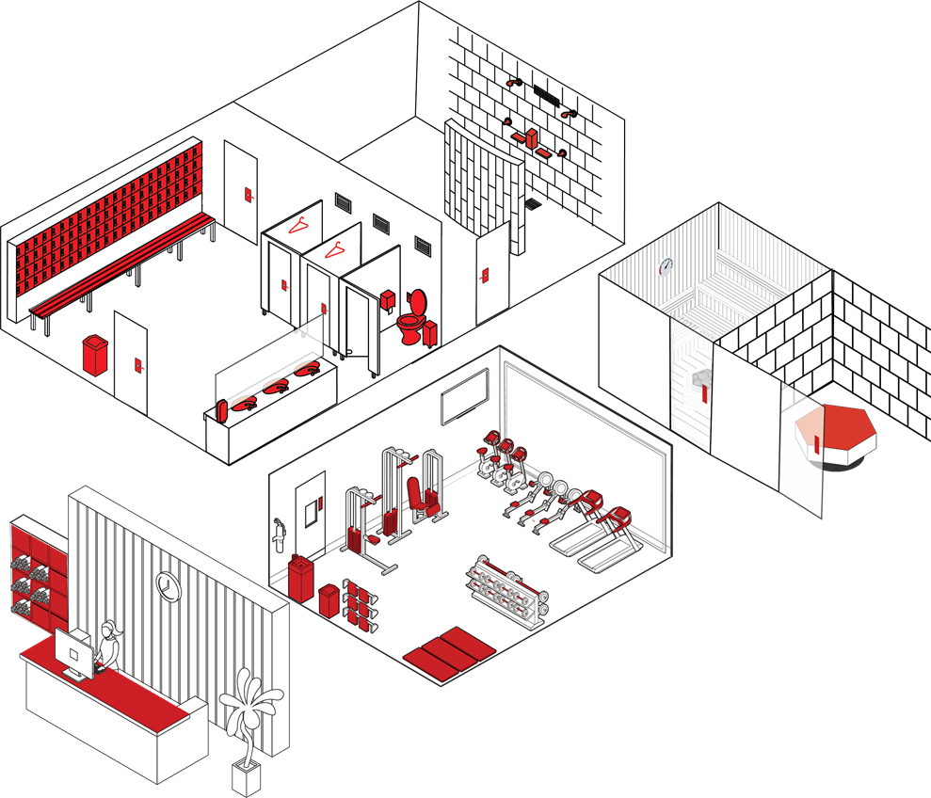

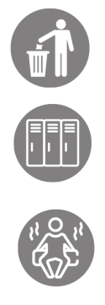
CLEANING FITNESS AREA - DISINFECTION
KEY TOUCHPOINTS
CLEANING PRODUCT
All handles
(not only doors)
Washrooms
Short contact time
Effective against SARS-CoV-2
Switches
Machine handles and seats
1 microfibre cloth or disposable cloth per zone
Dispensers (loaded, in good order, clean)
Rubbish bin
1 additional microfibre cloth of disposable cloth for outside of the toilet bowls and urinals
Water fountain
Lockers
Wipes available for Guests in the Fitness Room
Water taps
and sink
Sauna & hammam
CLEANING PROCESS
WHEN TO DO IT
Wash hands & put on gloves
Clean the key touchpoints
Dispose of dirty cloths in the laundry bag
Discard used gloves
Wash hands
Every hour
Check PIS, SDS for detailed information http://sds.diversey.com | Use biocides safely. Always read the label and product information before use

Slide 10
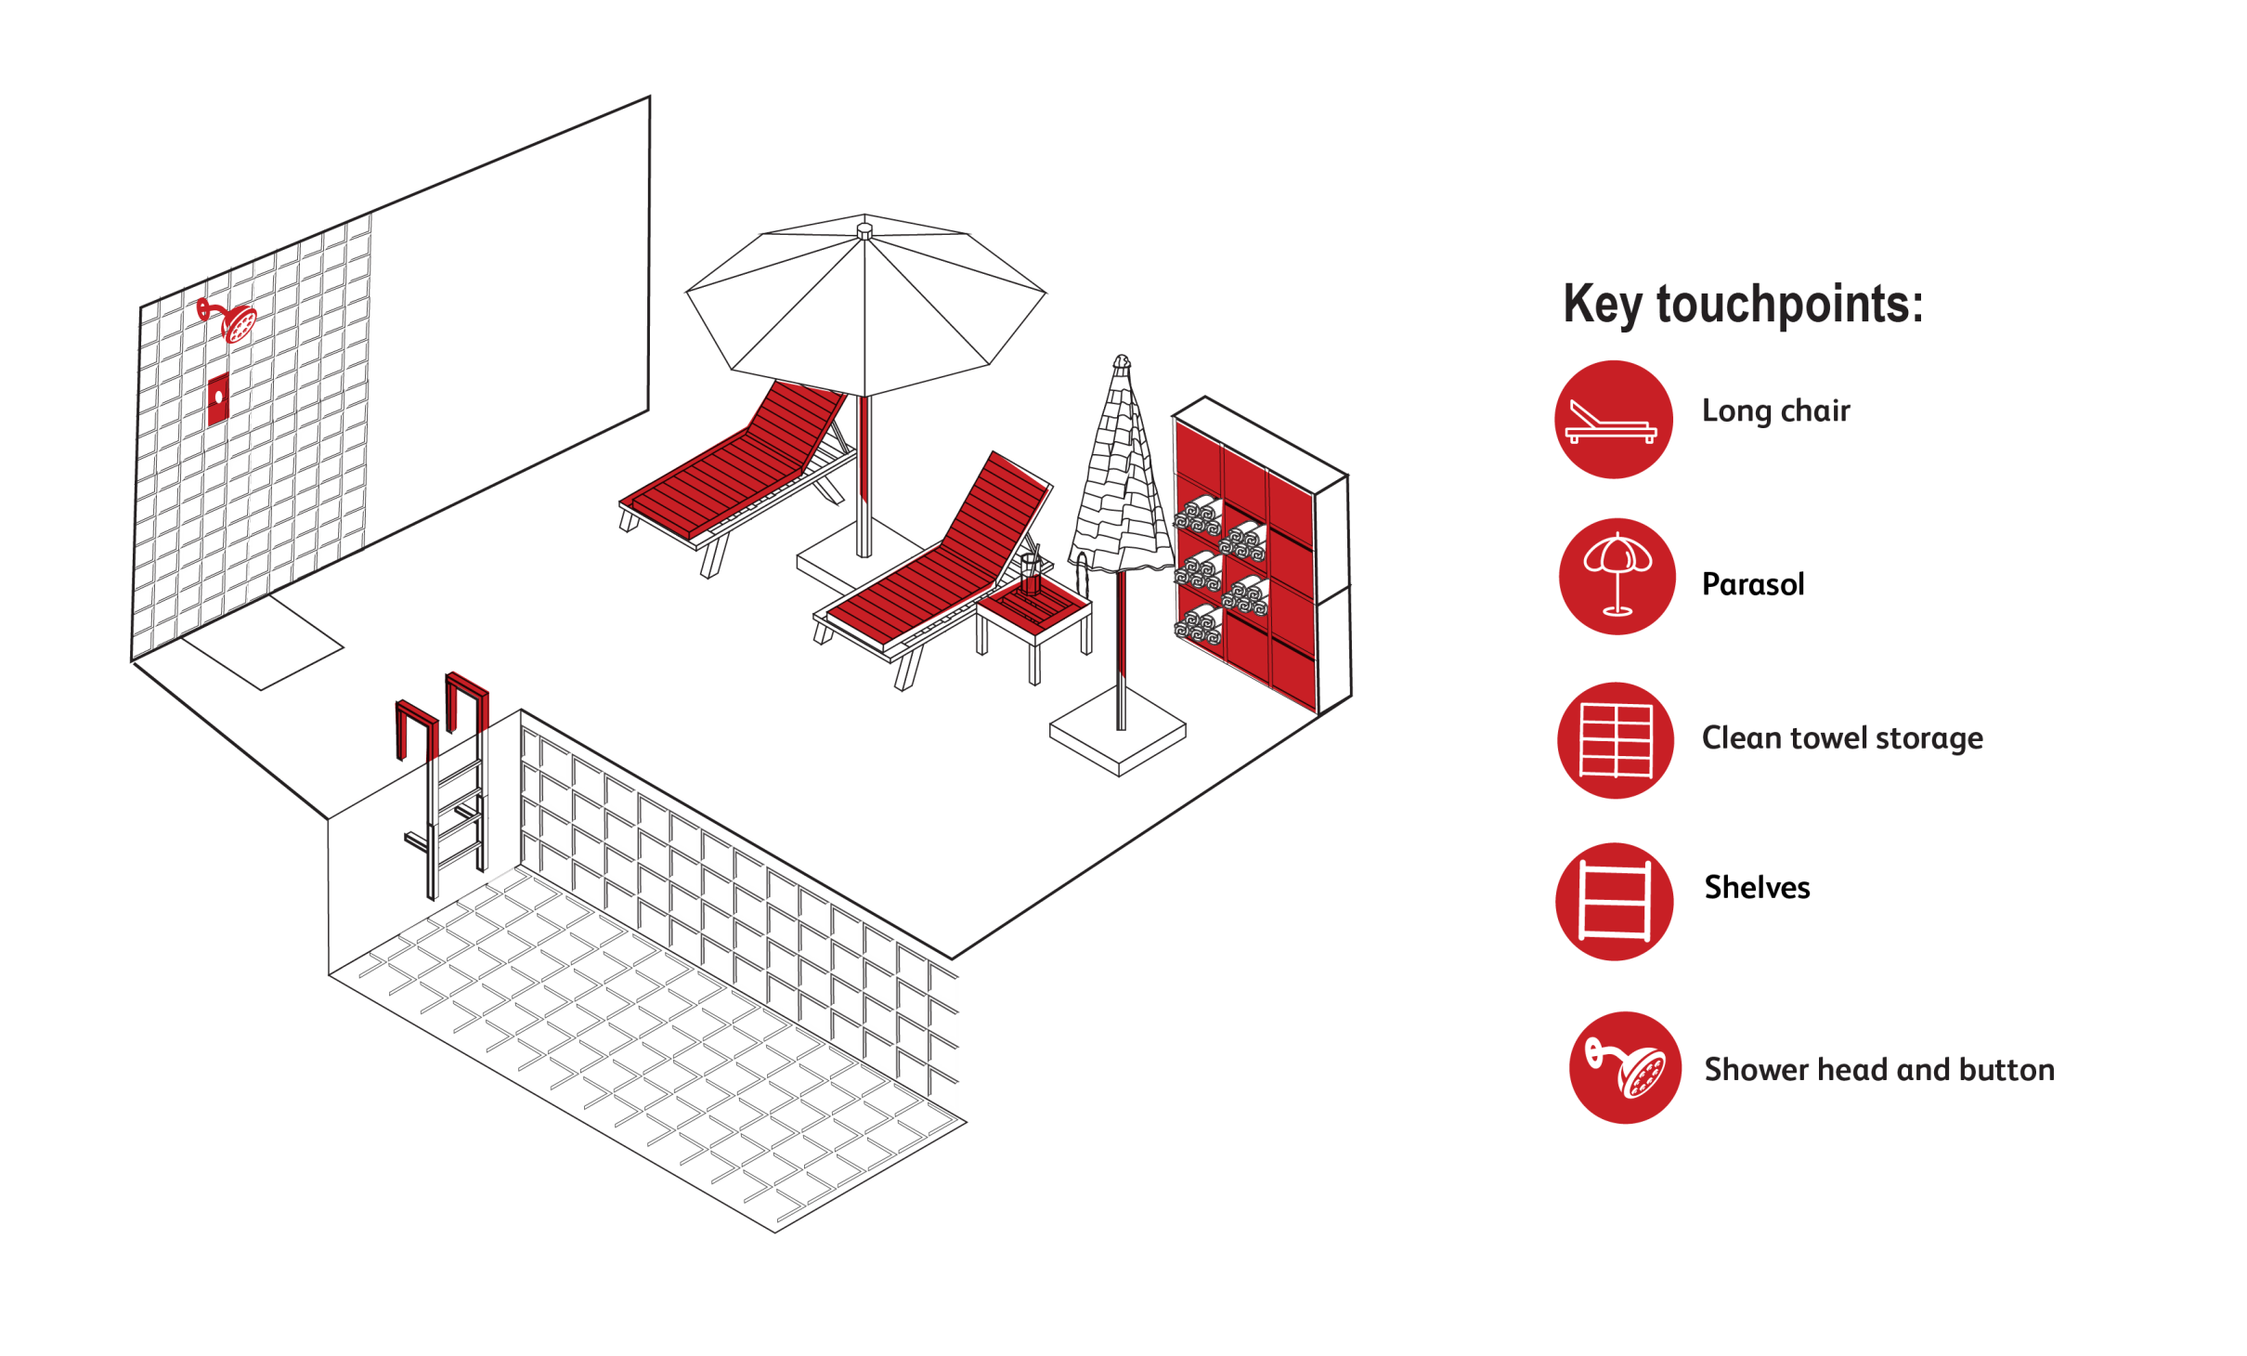
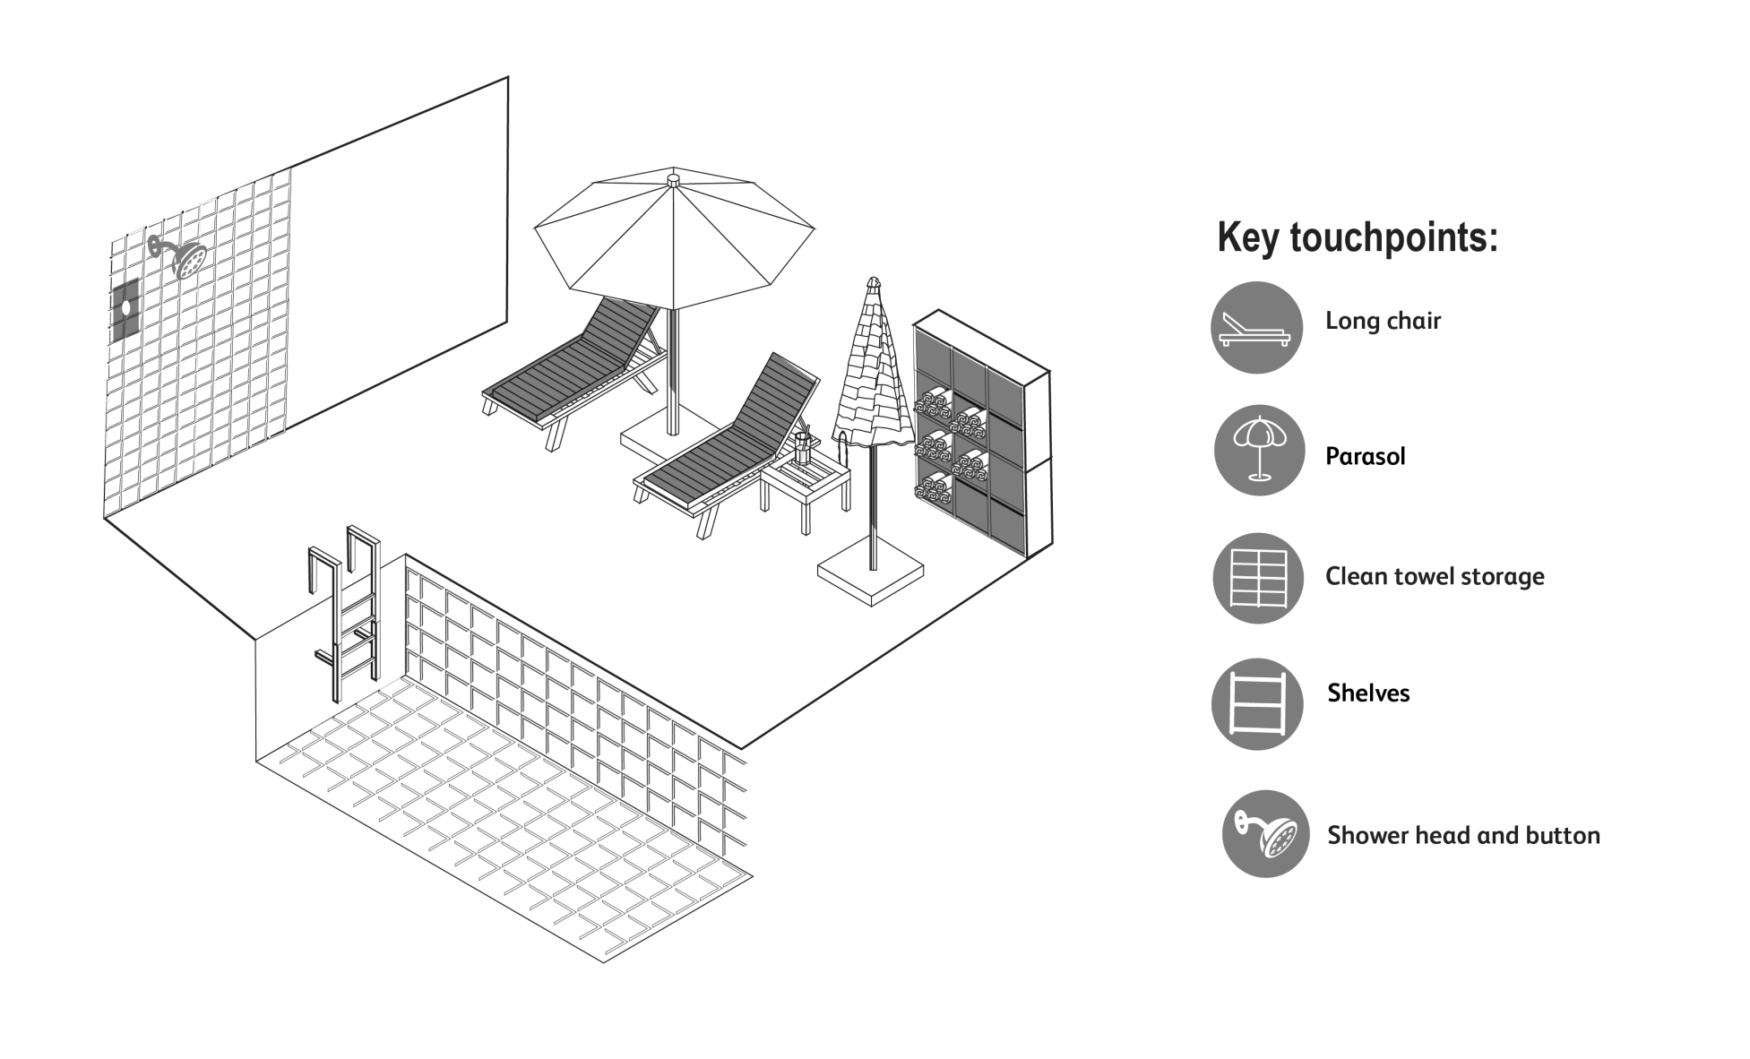




CLEANING POOL AREA - DISINFECTION
KEY TOUCHPOINTS
CLEANING PRODUCT
Long chair
Short contact time
Perfume free
Effective against SARS-CoV-2
Pool ladder
Shower head and
button
1 microfibre cloth or disposable cloth
Sunshades
Tables
* Use a different microfibre cloth colour from your current daily cleaning process for the enhanced cleaning
Towel shelves/storage
WHEN TO DO IT
CLEANING PROCESS
Every hour
Wash hands & put on gloves
Clean the key touchpoints
Dispose of dirty cloths in the laundry bag
Discard used gloves
Wash hands
Check PIS, SDS for detailed information http://sds.diversey.com | Use biocides safely. Always read the label and product information before use

Slide 11
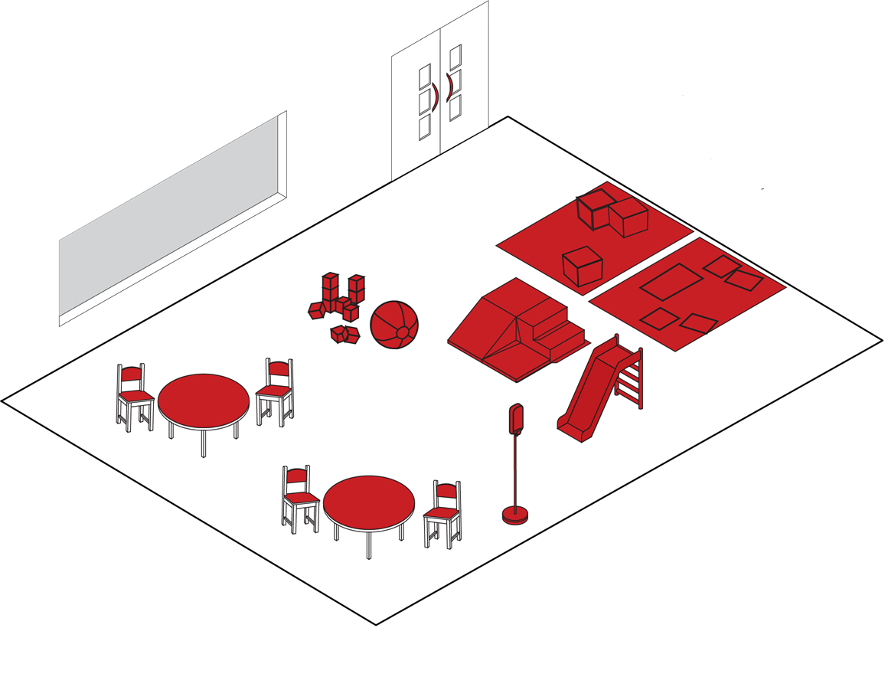

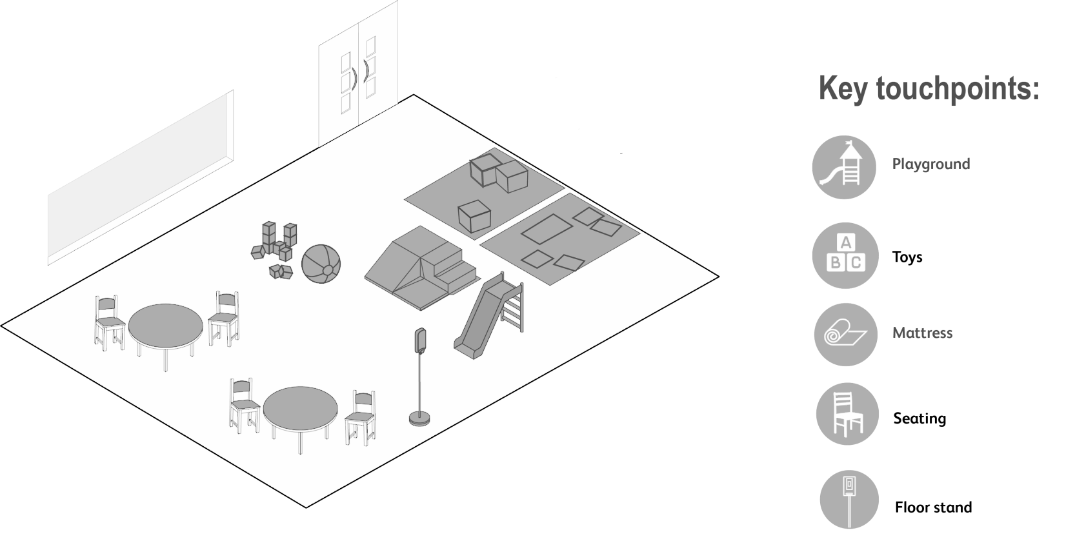




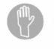

CLEANING KIDS CLUB - DISINFECTION
KEY TOUCHPOINTS
CLEANING PRODUCT
All door handles
Play areas
Short contact time
Effective against SARS-CoV-2
Table tops
Toys
Switches
Mattresses
1 microfibre cloth or disposable cloth
Hand contact surfaces
Chairs
* Use a different microfibre cloth colour from your current daily cleaning process for the enhanced cleaning
Hand disinfection stands
WHEN TO DO IT
CLEANING PROCESS
Every hour
Wash hands & put on gloves
Clean the key touchpoints
Dispose of dirty cloths in the laundry bag
Discard used gloves
Wash hands
Check PIS, SDS for detailed information http://sds.diversey.com | Use biocides safely. Always read the label and product information before use

Slide 12
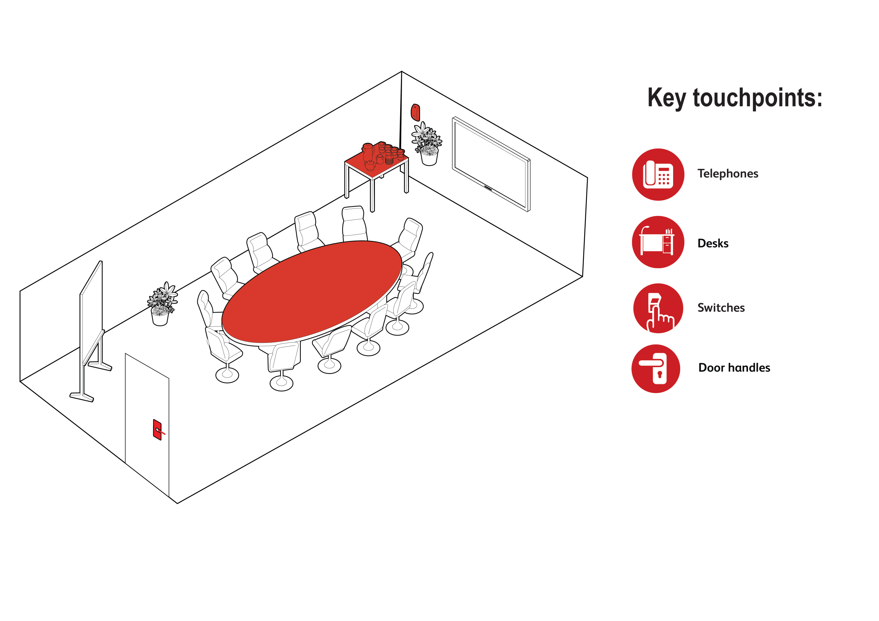


CLEANING CONFERENCE/MEETING ROOM- DISINFECTION
KEY TOUCHPOINTS
CLEANING PRODUCT
Desks, table tops, flip chart
Short contact time
Effective against SARS-CoV-2
Door handles
1 microfibre cloth* or disposable cloth
Meeting room accessories
Coffee machines, kettle etc.
Phone
* Use a different microfibre cloth colour from your current daily cleaning process for the enhanced cleaning
Remote control
Switches
WHEN TO DO IT
CLEANING PROCESS
After every meeting
Wash hands & put on gloves
Clean the key touchpoints
Dispose of dirty cloths in the laundry bag
Discard used gloves
Wash hands
Check PIS, SDS for detailed information http://sds.diversey.com | Use biocides safely. Always read the label and product information before use

Slide 13


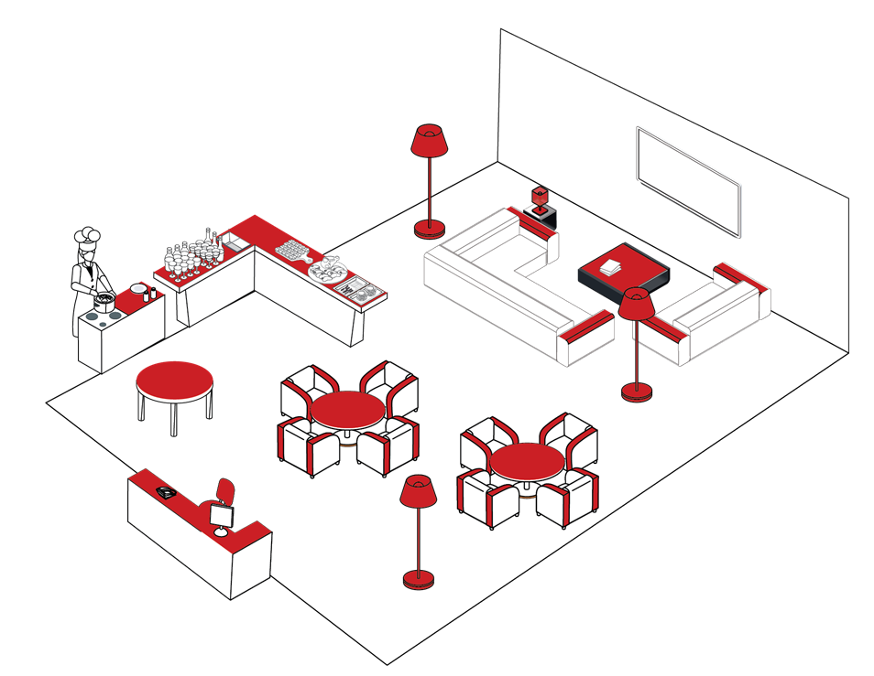


CLEANING CLUB LOUNGE - DISINFECTION
KEY TOUCHPOINTS
CLEANING PRODUCT
Armchairs
armrest
Switches
Short contact time
Effective against SARS-CoV-2
Coffee machine
Table tops
Furniture
handles
Phone
1 microfibre cloth or disposable cloth for cleaning
Lamp toggle switch
Food contact surfaces
For food surface contact areas
Short contact time
Perfume free
Effective against SARS-CoV-2
Counter top
Hand contact area:
Keyboard
1 microfibre cloth or disposable cloth to rinse
WHEN TO DO IT
CLEANING PROCESS
After every guest use
Wash hands & put on gloves
Clean the key touchpoints
Dispose of dirty cloths in the laundry bag
Discard used gloves
Wash hands
Check PIS, SDS for detailed information http://sds.diversey.com | Use biocides safely. Always read the label and product information before use

Slide 14
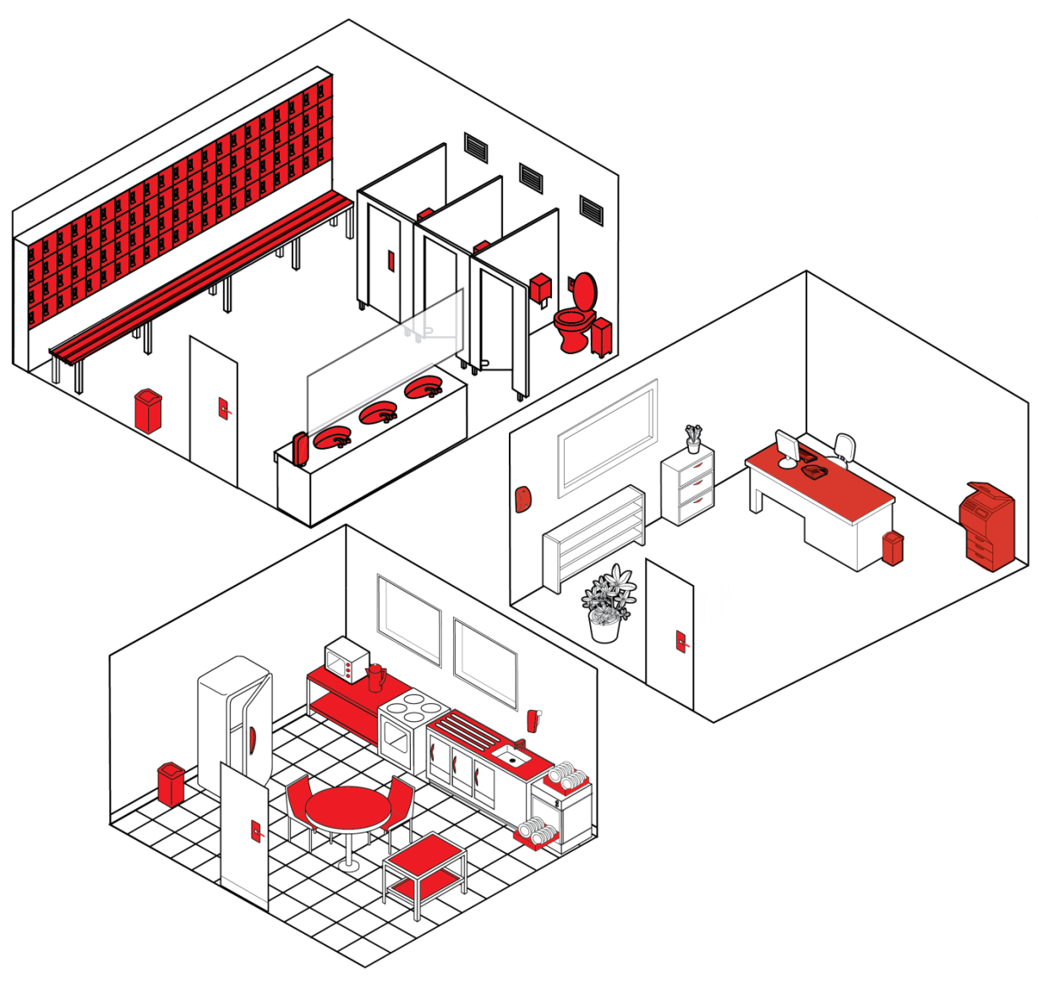





CLEANING COLLEAGUE FACILITIES - DISINFECTION
KEY TOUCHPOINTS
CLEANING PRODUCT
Chairs and
benches
Phone
Short contact time
Effective against SARS-CoV-2
All handles
(not only doors)
Switches
1 microfibre cloth or disposable cloth for cleaning
Desk
Tables
For food surface contact areas
Short contact time
Perfume free
Effective against SARS-CoV-2
Food contact
surfaces
Toilet seat, flush, splash wall
Hand contact
areas: Keyboard, printers…
Rubbish bin
1 microfibre cloth* or disposable cloth for the outside of the toilet bowls and the urinals
Dispensers (loaded, in good order, clean)
Water taps
1 microfibre cloth or disposable cloth to rinse
WHEN TO DO IT
CLEANING PROCESS
Every 2 hours
Wash hands & put on gloves
Clean the key touchpoints
For food surface contact areas: rinse thoroughly with water
Dispose of dirty cloths in the laundry bag
Discard used gloves
Wash hands
Check PIS, SDS for detailed information http://sds.diversey.com | Use biocides safely.
Always read the label and product information before use

Slide 15
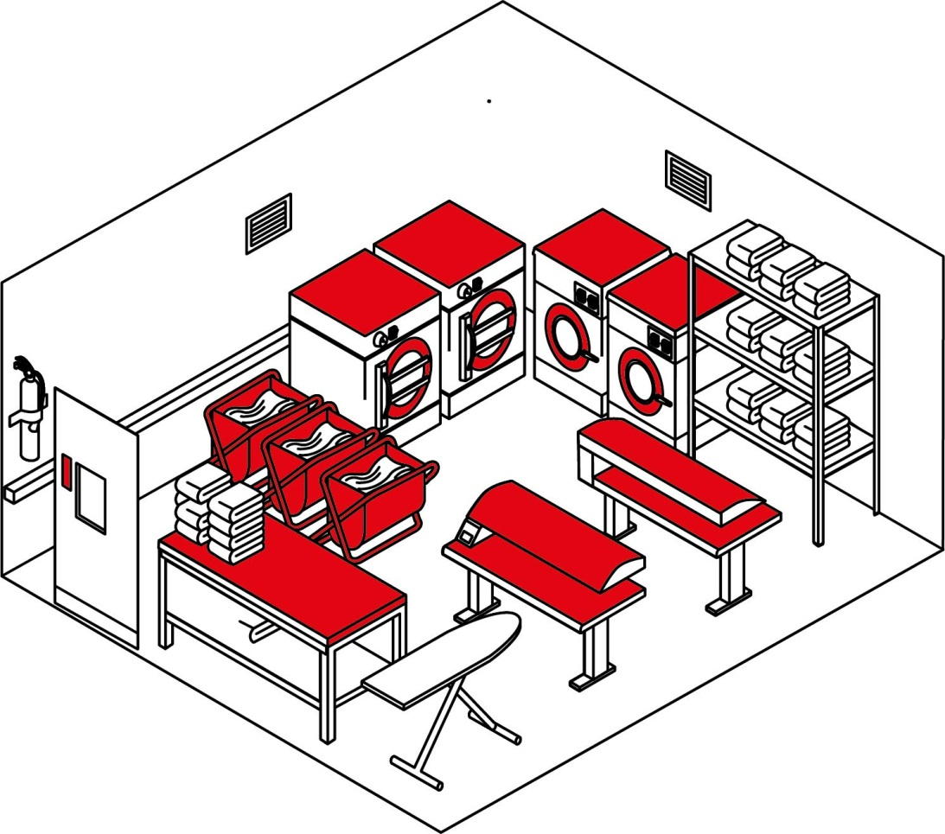

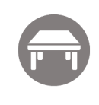



CLEANING LAUNDRY ROOM - DISINFECTION
KEY TOUCHPOINTS
CLEANING PRODUCT
All handles (not only doors)
Short contact time
Effective against SARS-CoV-2
Switches
Shelves
1 microfibre cloth* or disposable cloth for cleaning
Tables top
* Use a different microfibre cloth colour from your current daily cleaning process for the enhanced cleaning
Linen cart – in case of suspected case, after every use
Washing machine window and top – In case of suspected case, door seal and door handle after every wash
Dispensers (loaded, in good order, clean)
CLEANING PROCESS
Wash hands & put on gloves
Clean the key touchpoints
For food surface contact areas: rinse thoroughly with water
Dispose of dirty cloths in the laundry bag
Discard used gloves
Wash hands
WHEN TO DO IT
At least twice a day / after every shift
Check PIS, SDS for detailed information http://sds.diversey.com | Use biocides safely. Always read the label and product information before use

Slide 16
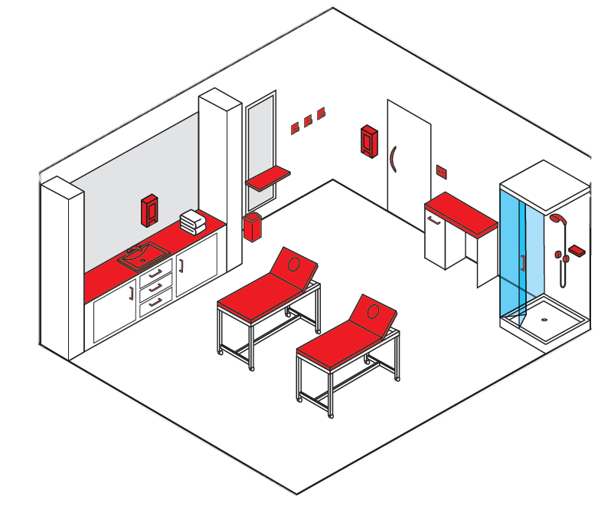





CLEANING SPA TREATMENT ROOM - DISINFECTION
KEY TOUCHPOINTS
CLEANING PRODUCT
All handles (not only doors)
Hangers
Short contact time
Effective against SARS-CoV-2
Switches
Massage tables
1 microfibre cloth* or disposable cloth for cleaning
Shower head, shower control
Dispensers (loaded, in good order, clean)
Tables top
1 microfibre cloth or disposable cloth to rinse
Sink, water tap
Rubbish bin
* Use a different microfibre cloth colour from your current daily cleaning process for the enhanced cleaning
WHEN TO DO IT
CLEANING PROCESS
After every guest
Wash hands & put on gloves
Clean the key touchpoints
Dispose of dirty cloths in the laundry bag
Discard used gloves
Wash hands
Check PIS, SDS for detailed information http://sds.diversey.com | Use biocides safely. Always read the label and product information before use

